Slide 1

Computer Networks Assignment
Topic : Networking Commands
Roll No : 49 – 54
Class : MCA Sem I
Date : 28-04-2022
Place : Bengaluru

Slide 2
Group Members :
Khairunisa(RVCE21MCA086)
Kiran H S(RVCE21MCA036)
Y S Kiran Kumar(RVCE21MCA039)
Kiran Naik(RVCE21MCA088)
Kishankumar Dahiya(RVCE21MCA031)
K B Krishna(RVCE21MCA059)

Slide 3
Network Commands
ip link
ip link show
ip address show
Ip route show
nmap
ping
iperf
traceroute
tcpdump
netstat
ss
ssh
scp
sftp
ifconfig
dig
telnet
nslookup

Slide 4
$ip command
Purpose
Internet protocol command.
Used to display and modify, configure network interfaces.
ip command is a Linux net-tool for system and network administrators.
Syntax
$ip [OPTION] OBJECT {COMMAND | help}
OBJECTS (or subcommands) that you will use most often include:
1. link (l) – used to display and modify network interfaces.
2. address (addr/a) – used to display and modify protocol addresses (IP, IPv6).
3. route (r) – used to display and alter the routing table.
4. neigh (n) – used to display and manipulate neighbor objects (ARP table).

Slide 5
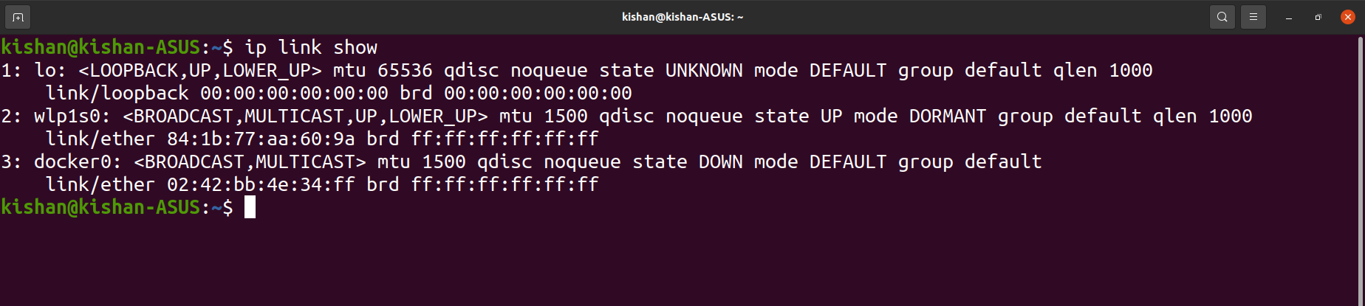
ip link : Used to configure network interfaces.
Examples
To see link layer information of all available devices.
$ip link show

Slide 6
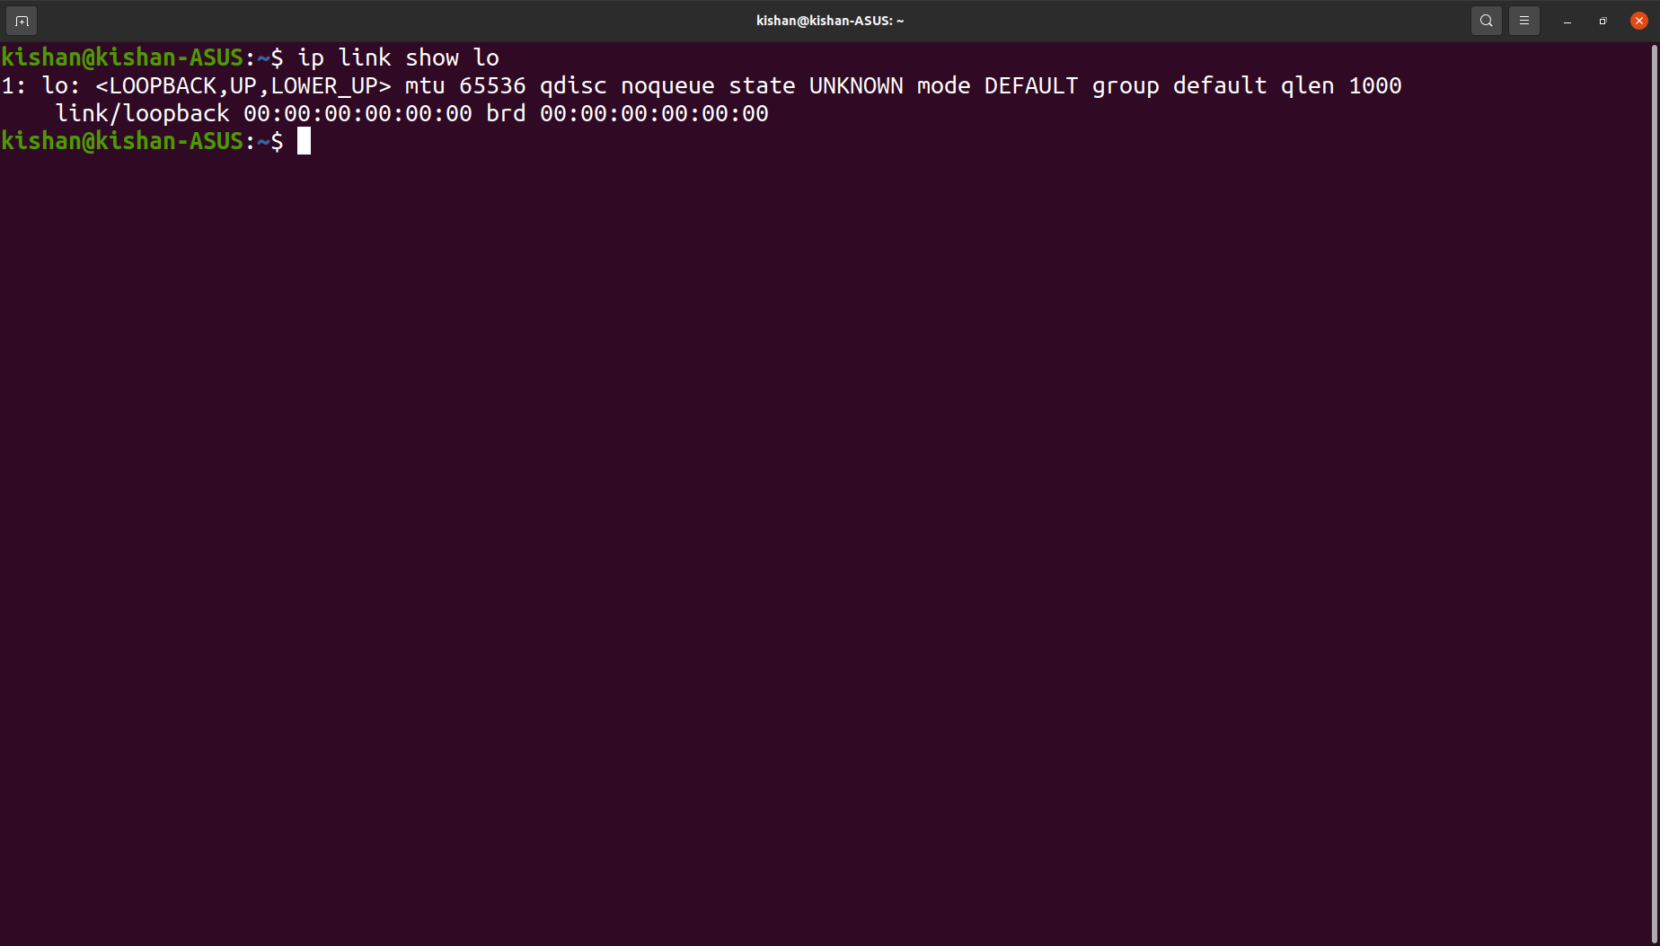
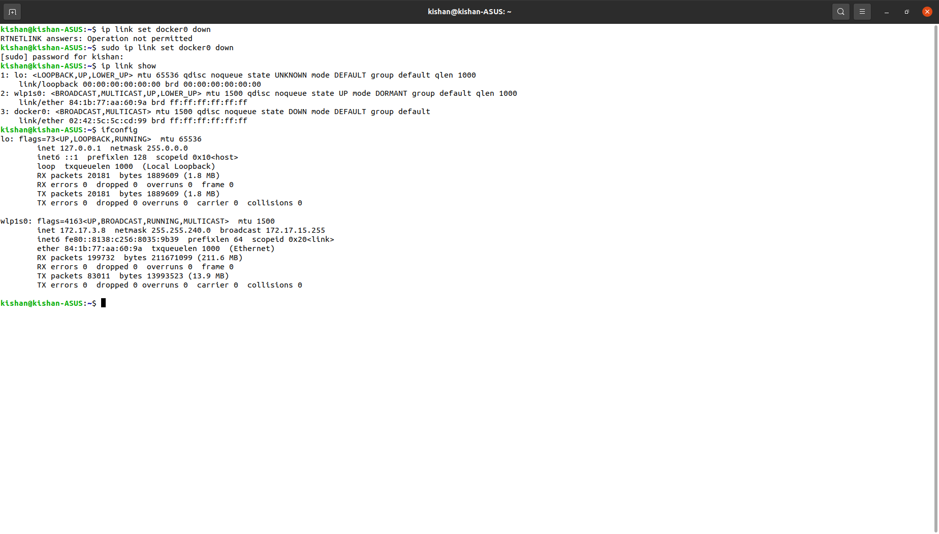
Display information for specific interface.
$ip link show [interface]
Bring a network interface up (online) / down(offline)
$ip link set [interface] up/down

Slide 7
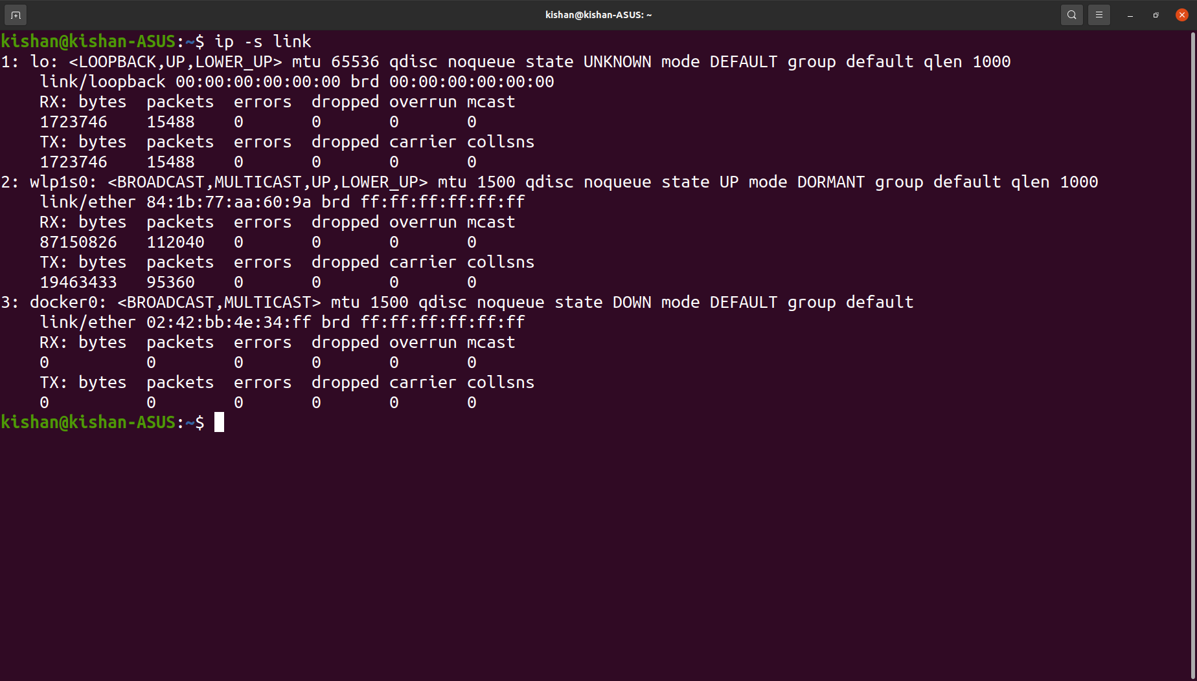
Display statistics of all network interfaces.
$ip -s link

Slide 8
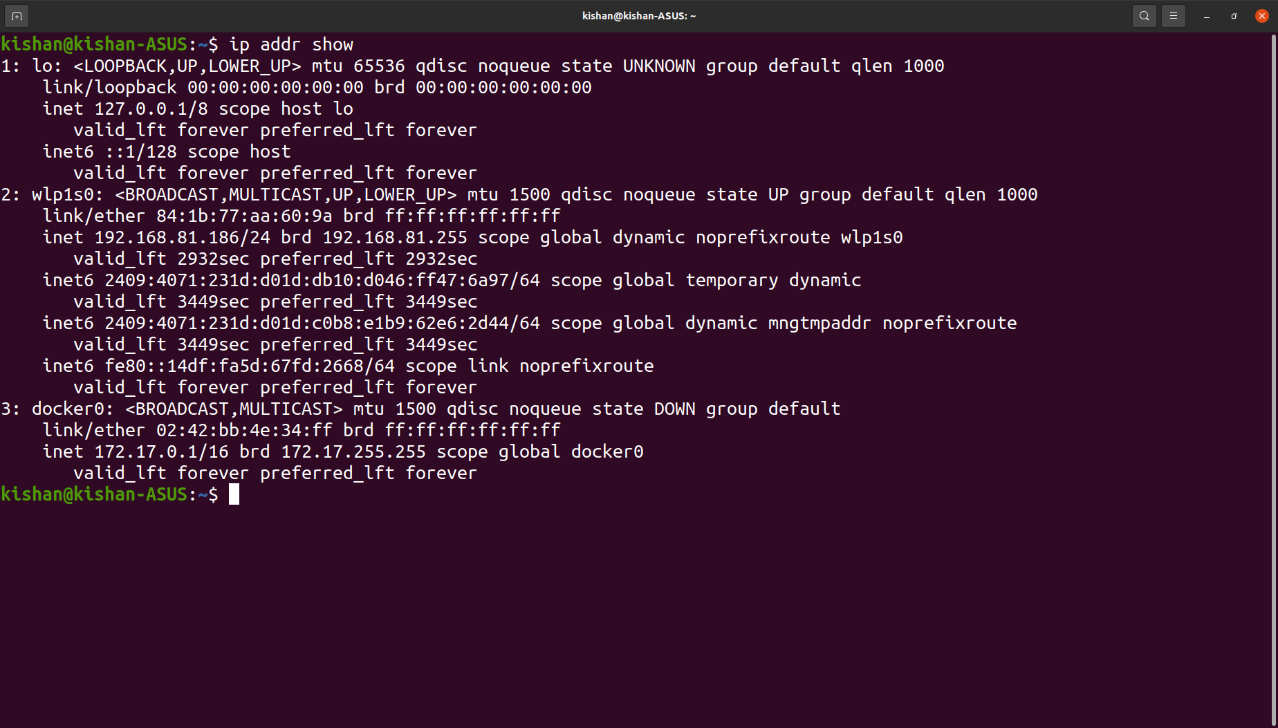
ip addr show : To monitor all network interfaces and the associated IP Addresses, use this command.
Examples
To see link layer information of all available devices.
$ip addr show

Slide 9
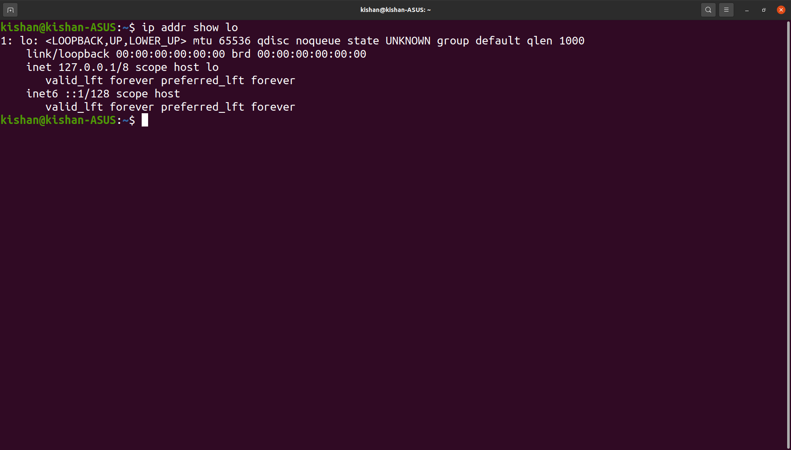
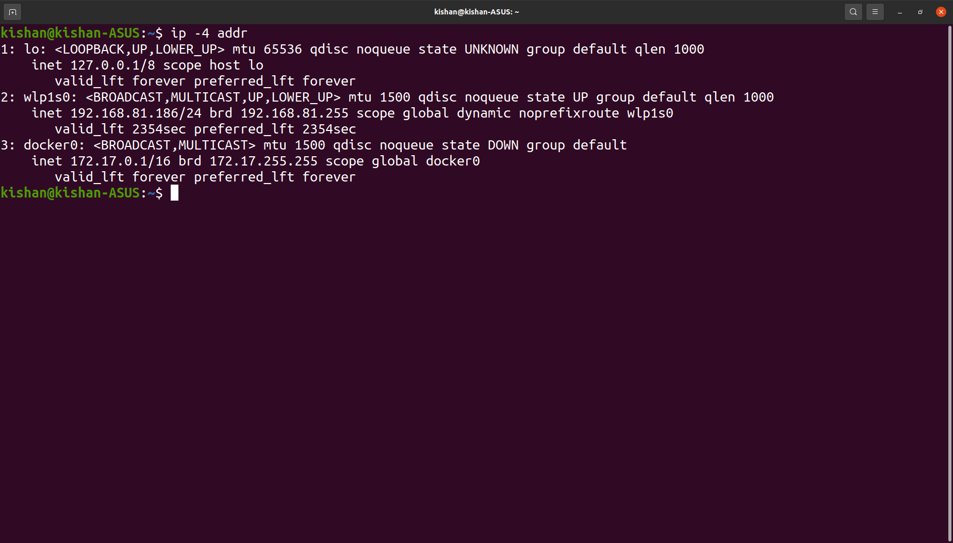
Check information about induvidual network.
$ip addr show [interface]
To list the IPv4/IPV6 addresses.
$ip -4/-6 addr

Slide 10
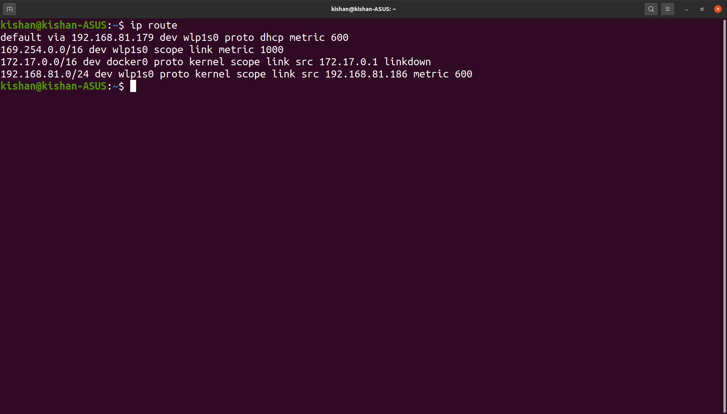
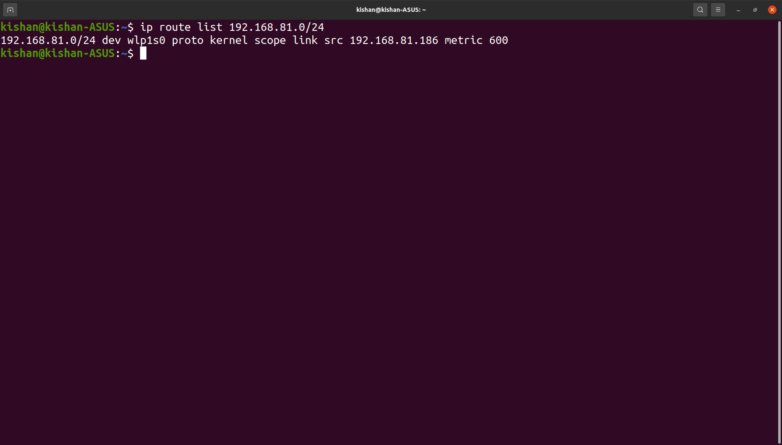
ip route show : Manage and display IP routing table.
Examples
List all route entries.
$ip route / $ip ro / $ip route list
Show route using IP Address.
$ip route list [ip address]

Slide 11
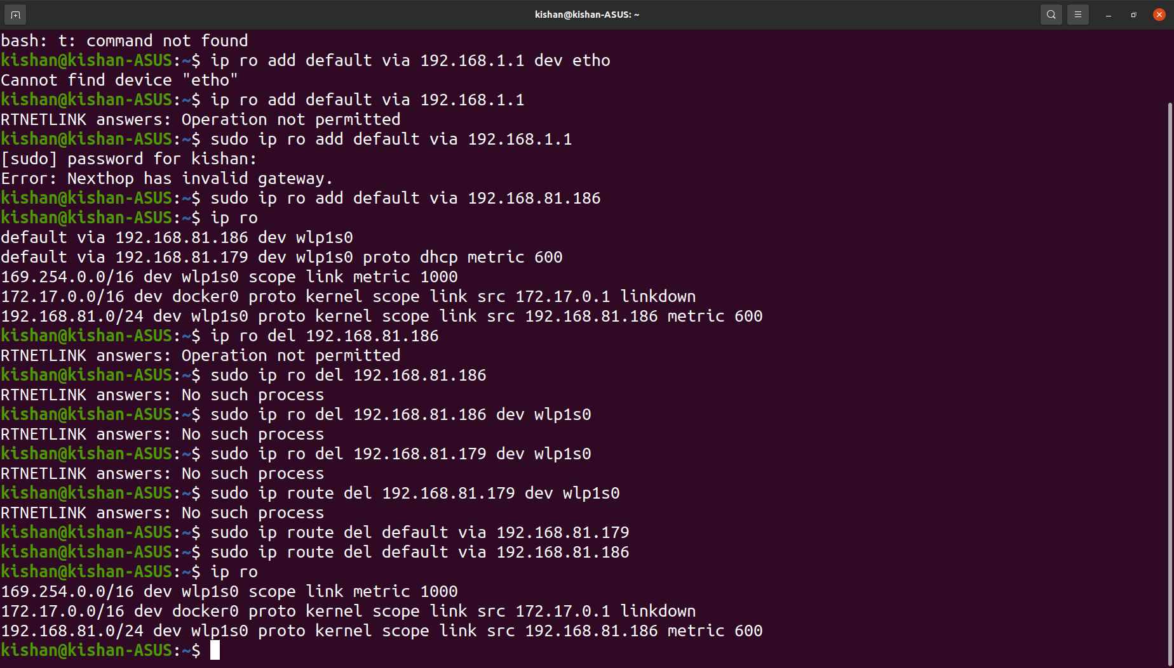
Delete a default route by IP Address
$sudo ip route del [IP Address]
Add a default route via local gateway.
$sudo ip ro add default via 192.168.81.186

Slide 12
$nmap command
Purpose
Network mapper, used for network exploration and security.
With nmap server administrator can quickly reveal hosts and services,search for security issues and scan for open ports.
Can discover and audit local and remote open ports, as well as network information & hosts.
Syntax
$nmap [Scan Type...] [Options] {target specification}

Slide 13
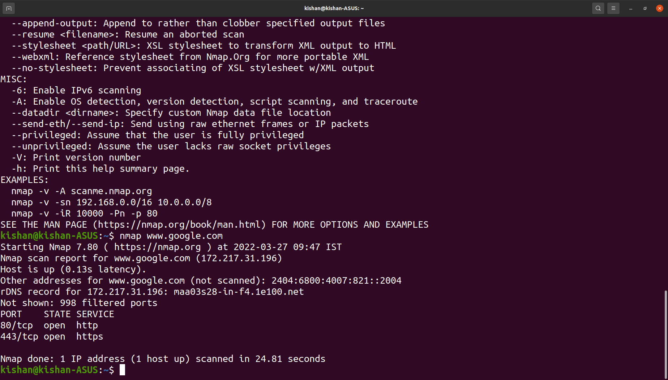
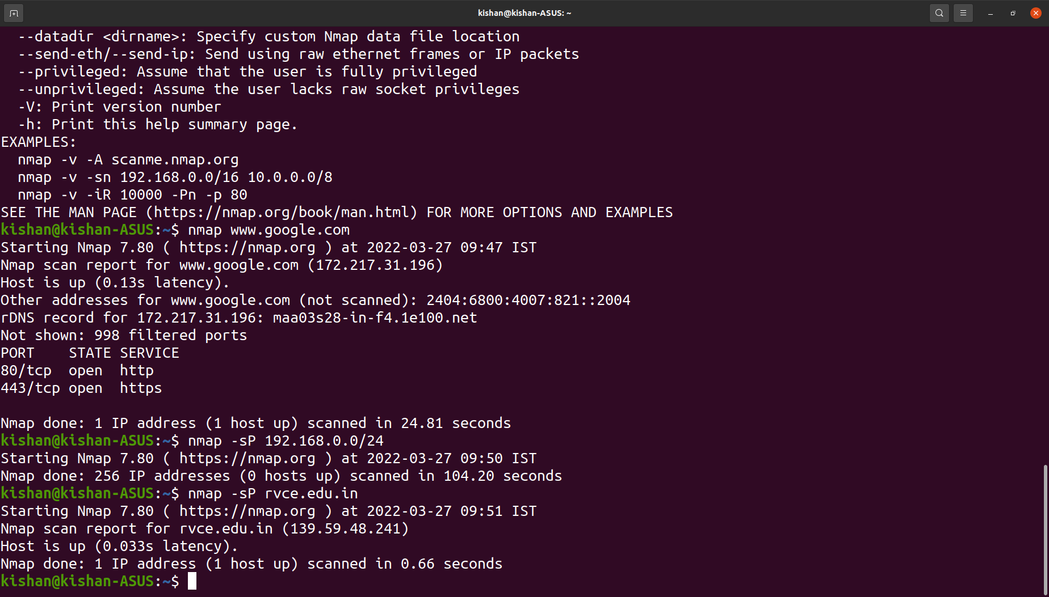
Examples
A basic nmap command will produce information about given host.
$nmap www.google.com / subdomain.server.com
Scan to see which servers are active. The -sP command locates machines, makes sure machine are responding.
$nmap -sP 192.168.0.0/24 / $nmap -sP rvce.edu.in

Slide 14
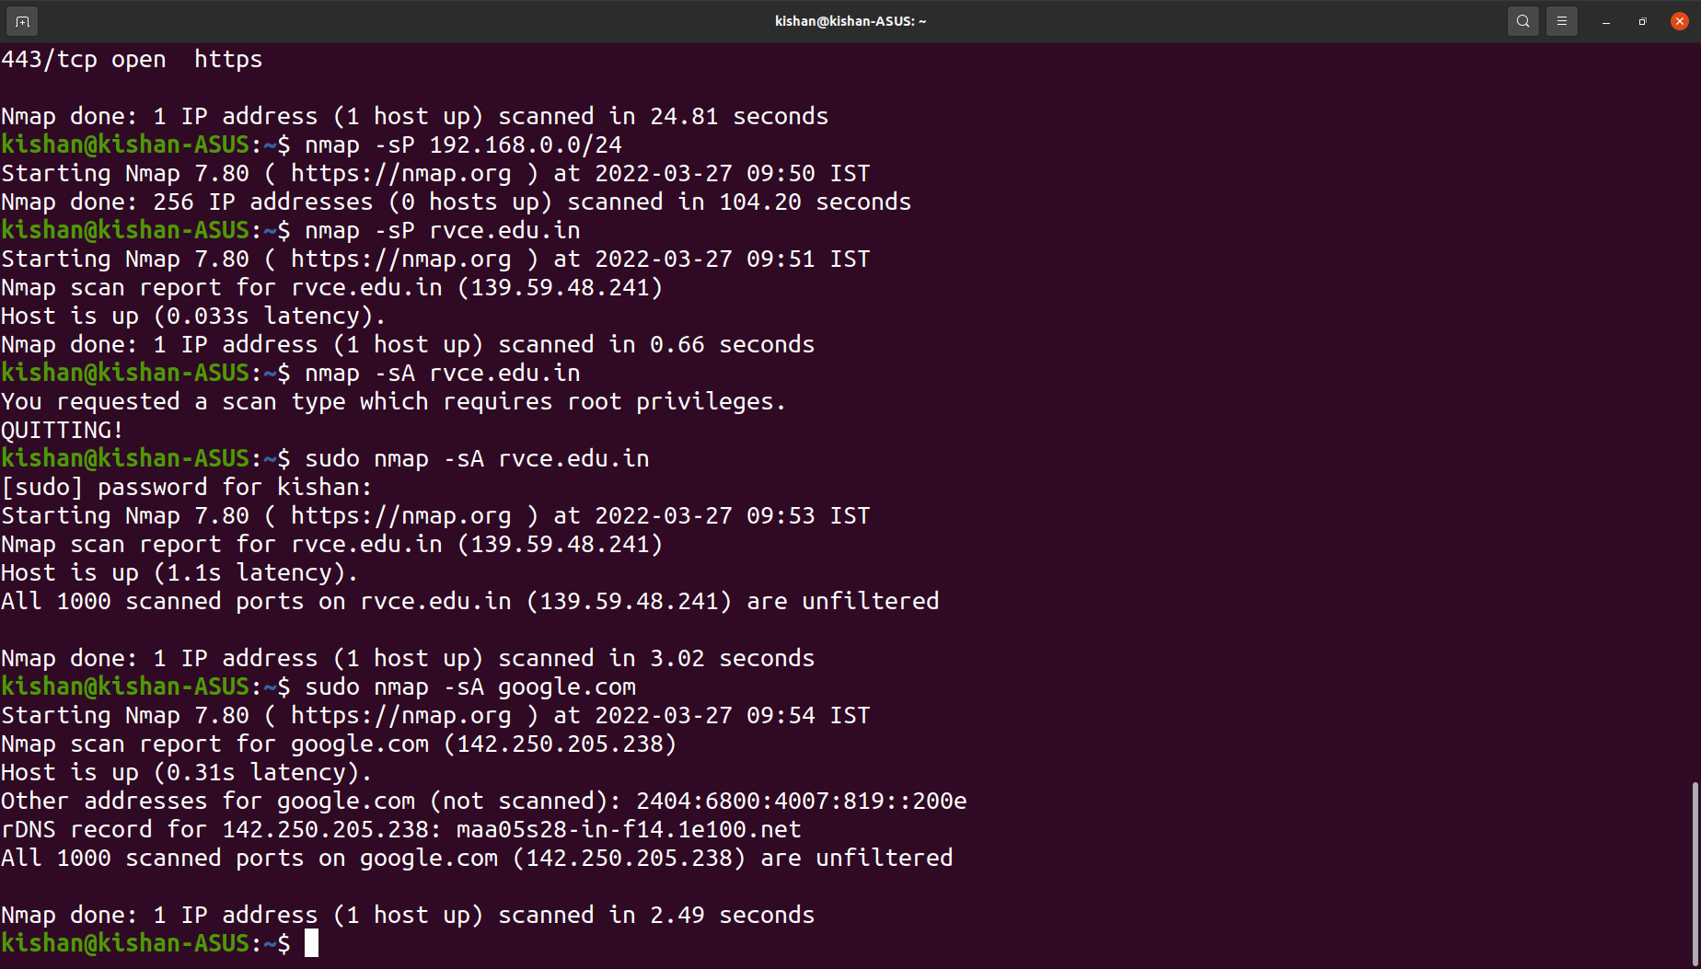
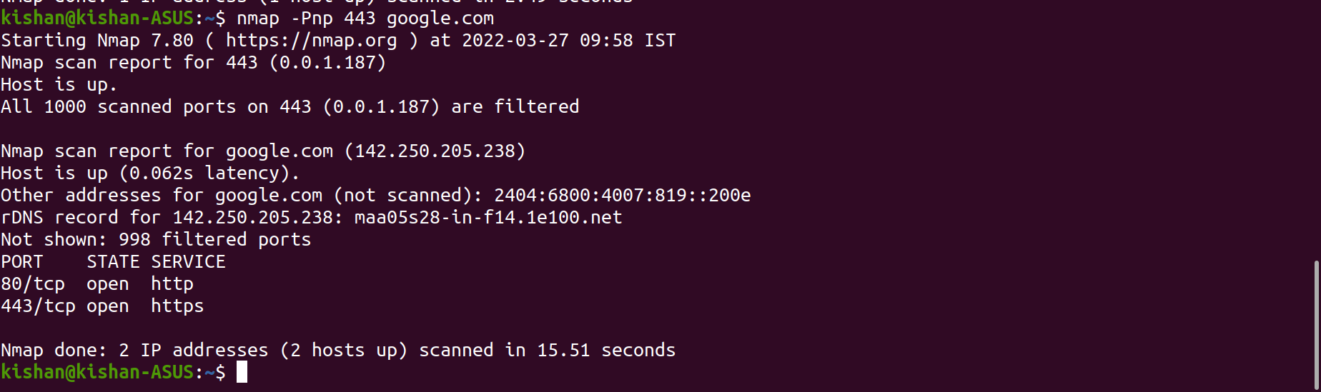
Scan to check if firewall is active or not on the host.
$sudo nmap -sA google.com
Scan for port.
$nmap -Pnp 443 google.com

Slide 15
$ping command
Purpose.
Check if remote machine is online by sending and receiving packets.
Analyse if there are network issues like dropped packages or high latency
Syntax
$ping [-aAbBdDfhLnOqrRUvV46] [-c count] [-F flowlabel] [-i interval] [-I interface] [-l preload] [-m mark] [-M pmtudisc_option] [-N nodeinfo_option] [-w deadline] [-W timeout] [-p pattern] [-Q tos] [-s packetsize] [-S sndbuf] [-t ttl] [-T timestamp option] [hop...] {destination}

Slide 16
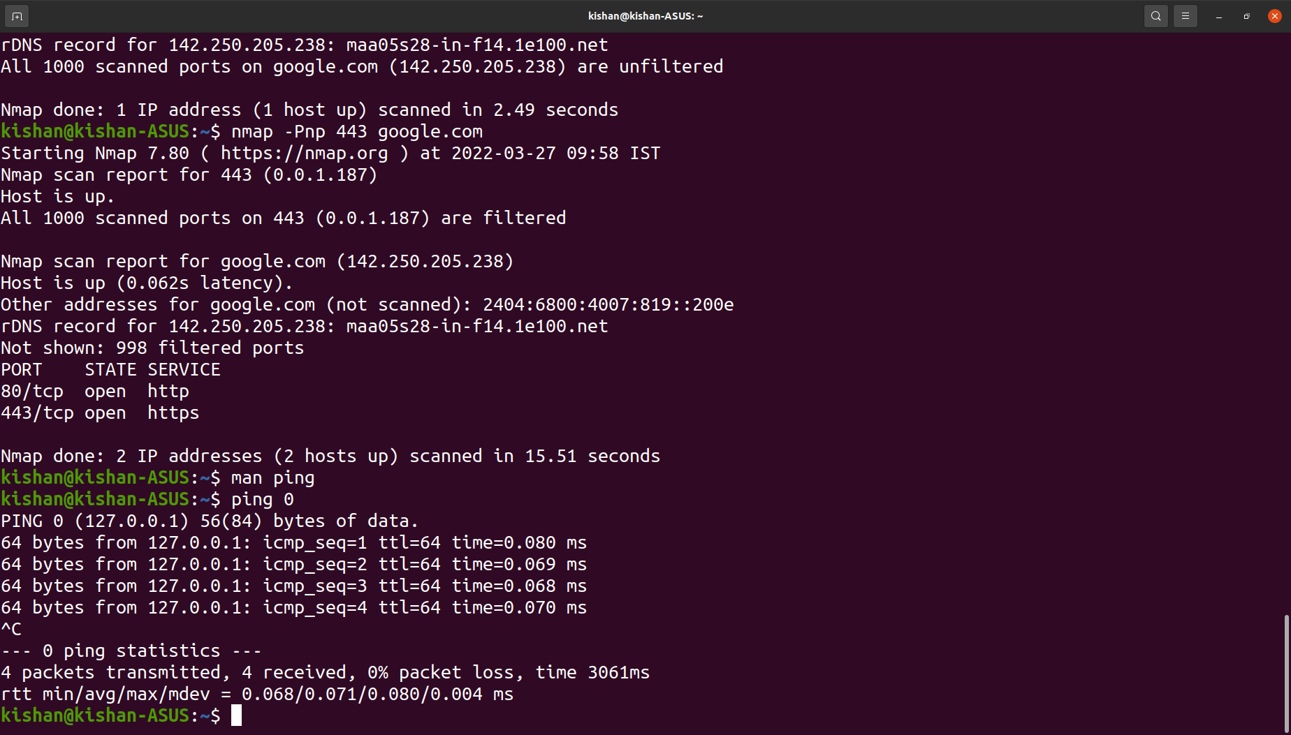
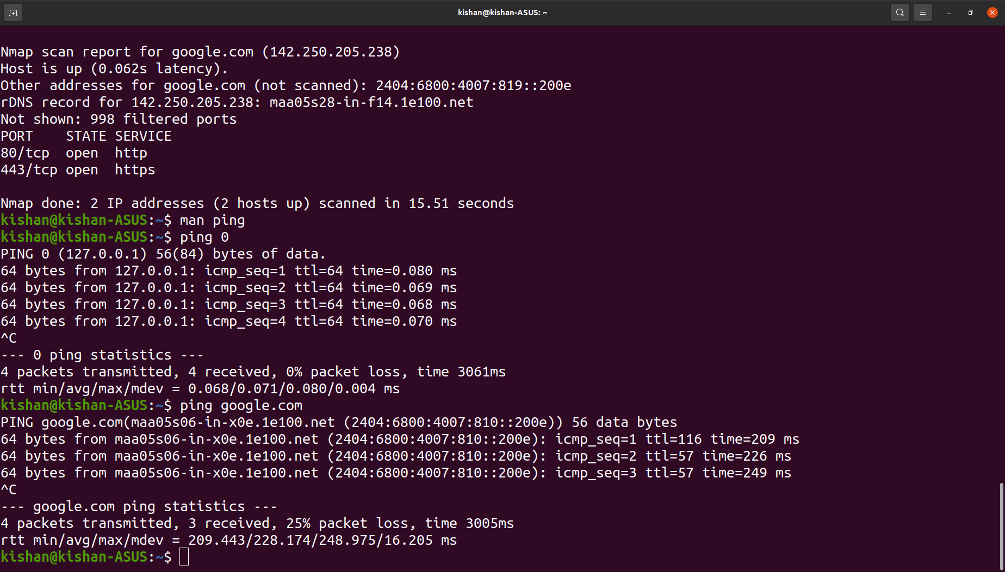
Examples
Ping localhost to check local network.
$ping 0 / $ping localhost / $ping 127.0.0.1
To check if remote host is up.
$ping google.com

Slide 17
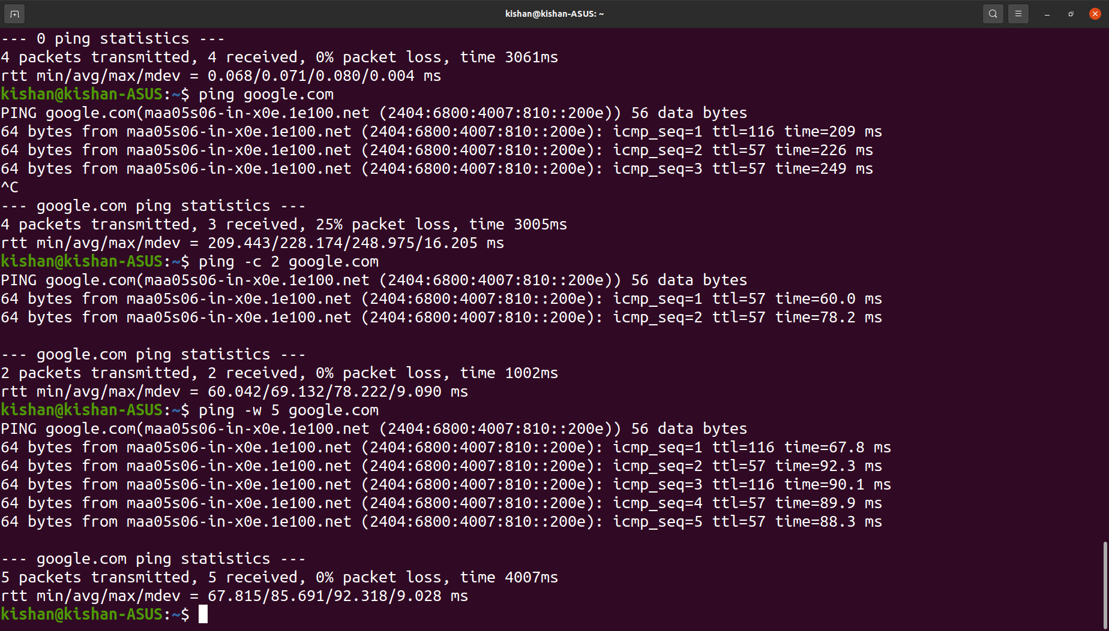
Limit number of ping packets.
$ping -c 2 google.com
Set time for ping command.
$ping -w 5 google.com

Slide 18
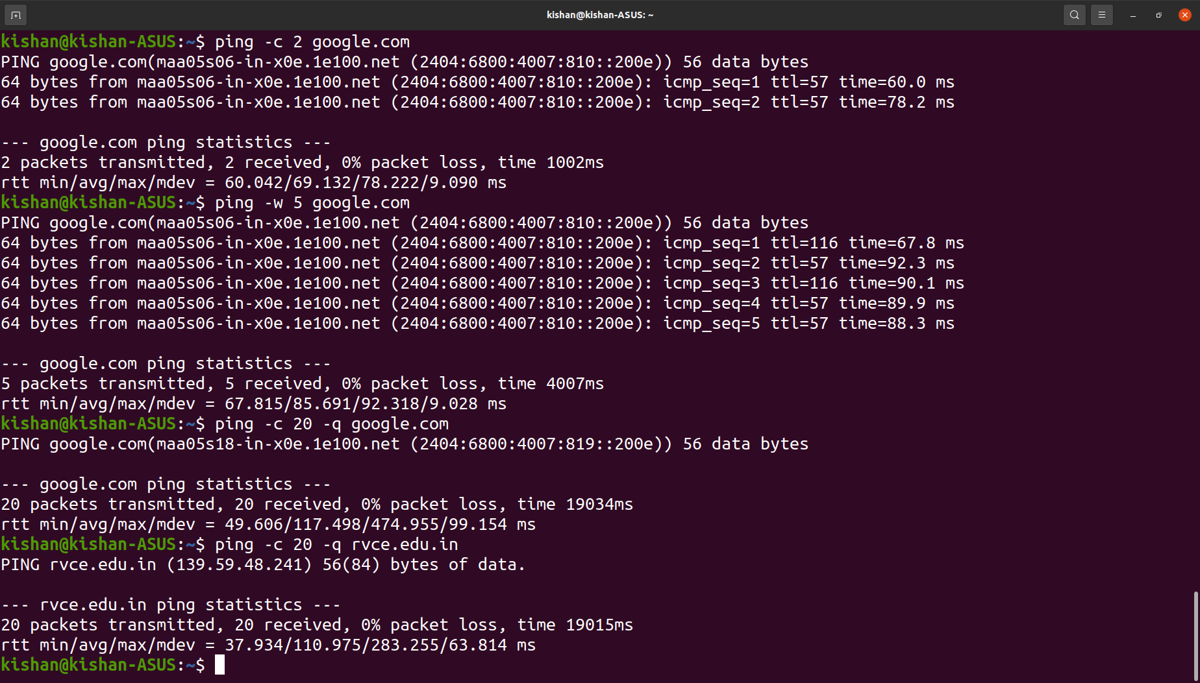
Ping quietly, only statistics are displayed.
$ping -c 10 -q rvce.edu.in

Slide 19
$iperf command
Purpose
Open Source Network tool.
Used to measure throughput or performance or a network.
Can be used to test TCP/UDP.
Syntax
$iperf -s [options]
$iperf -c server [options]
$iperf -u -s [options]
$iperf -u -c server [options]

Slide 20
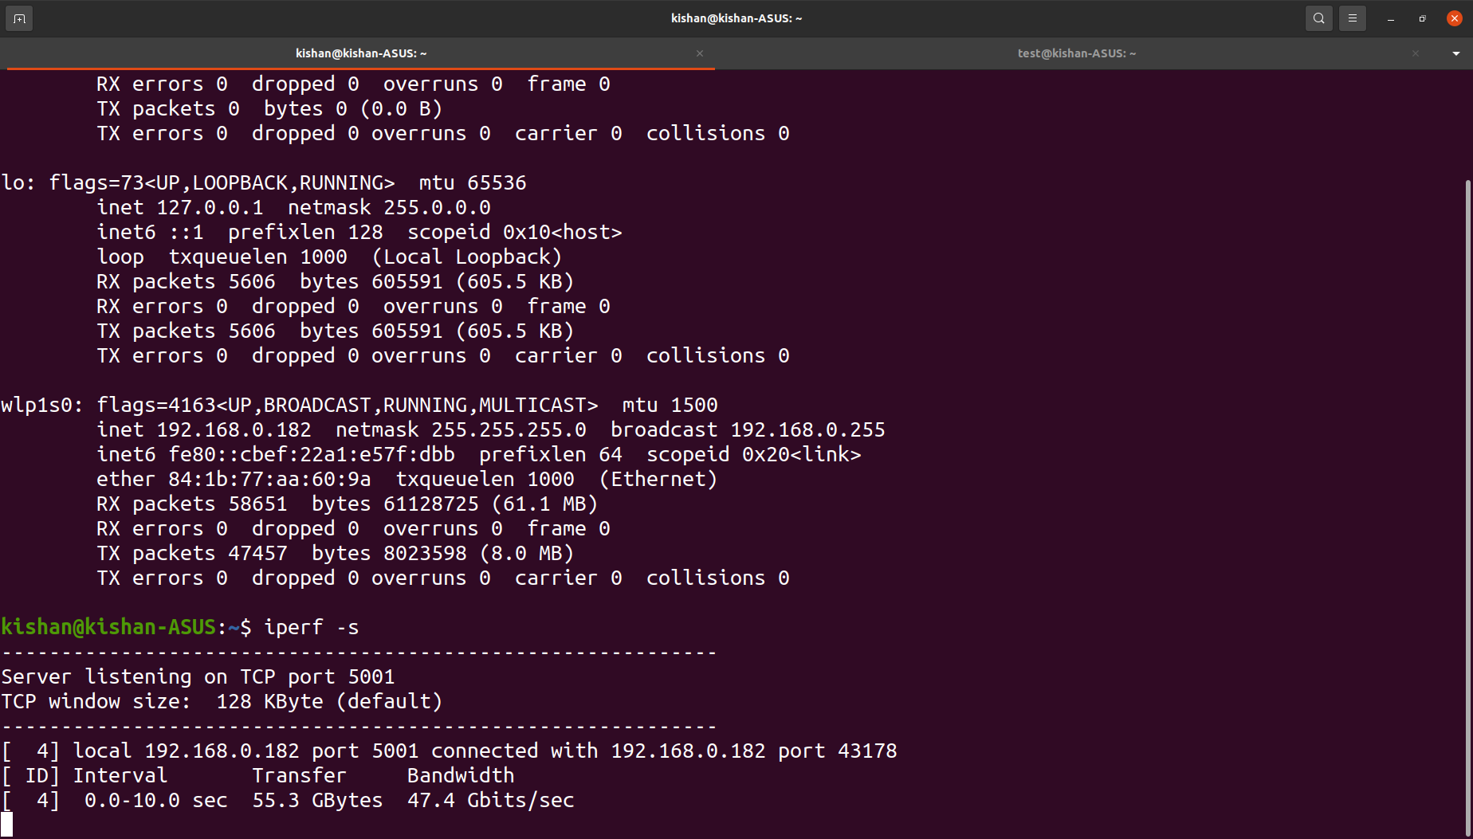
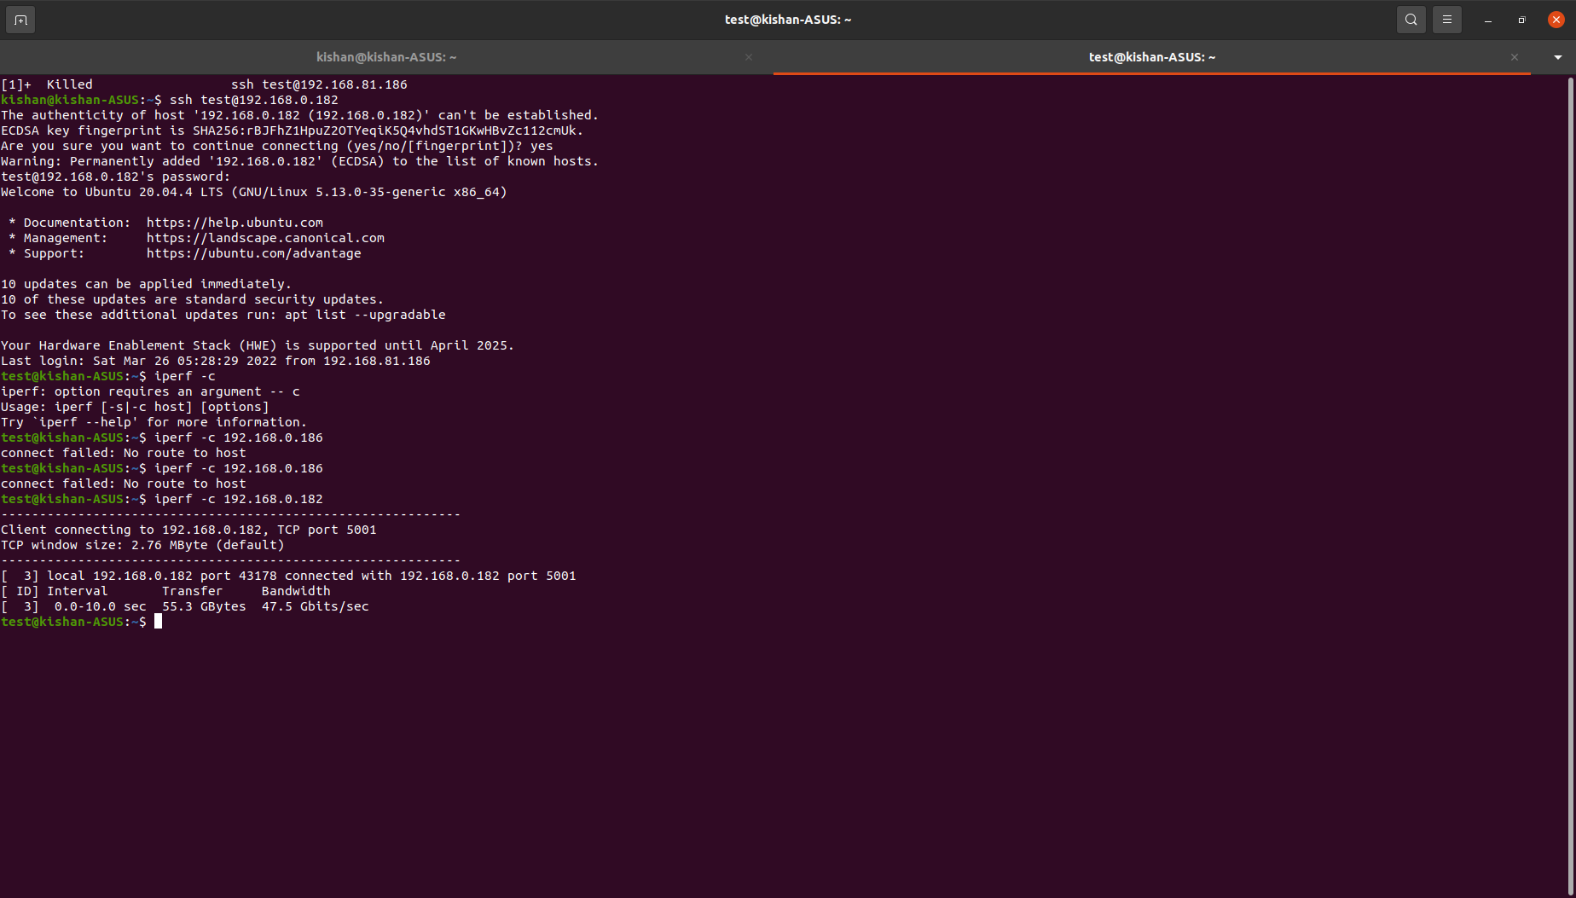
Examples
Run the server(TCP) and client. Connect 2 instances(users)
Server Side
$iperf -s
Client Side
$iperf -c [server_IP_Address]

Slide 21
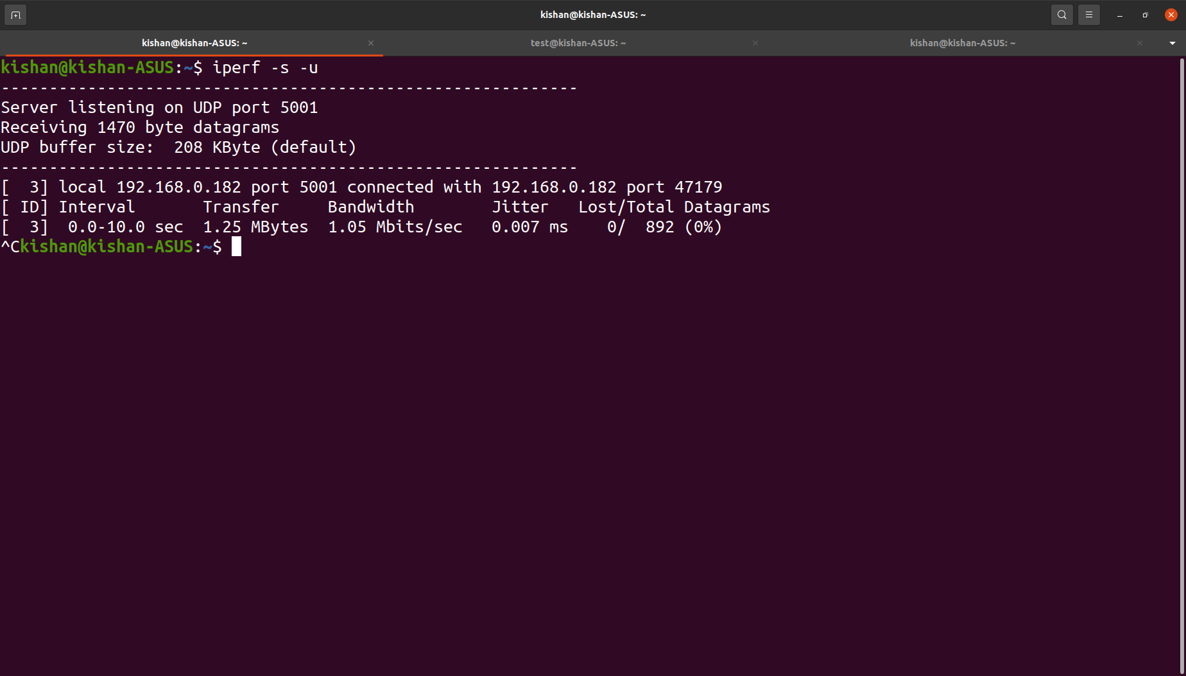
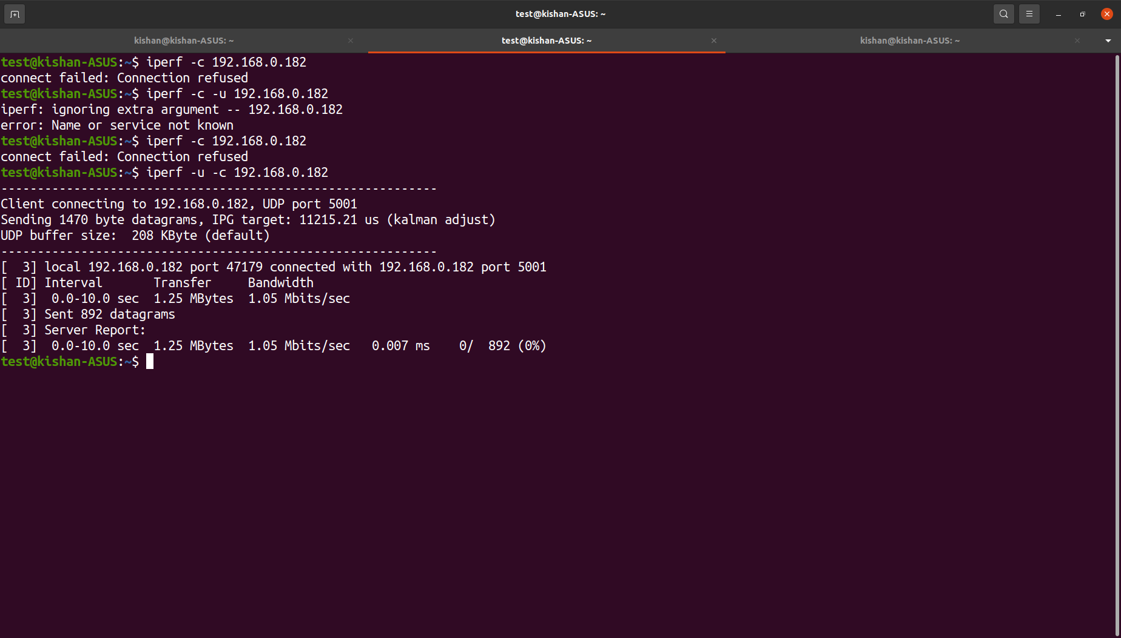
Run the server(UDP) and client. Connect 2 instances(users)
Server Side
$iperf -s -u
Client Side
$iperf -u -c [server_IP_Address]

Slide 22
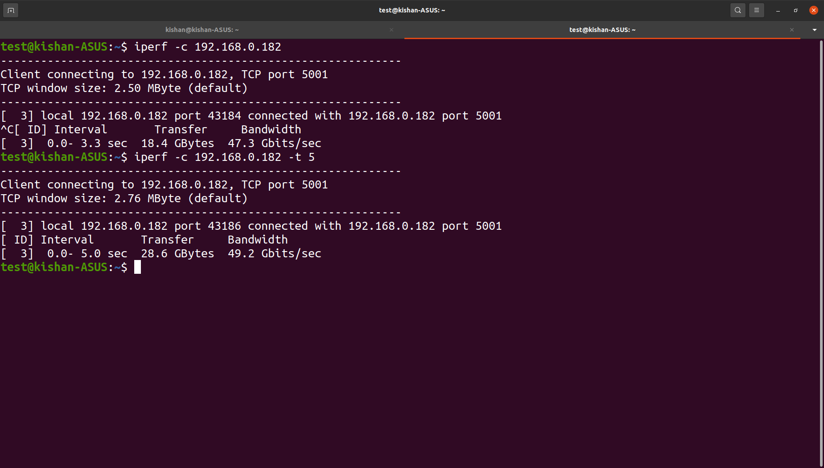
Send data for N seconds in client mode.
$iperf -c 192.168.0.182 -t 5

Slide 23
$traceroute command
Purpose
Monitoring command, tells us about complete path that a packet uses to reach destination.
Discover the names & identity of routers & devices within the path.
Find the time it took to send & receive data to each device on the path.
Syntax
$ traceroute [-46dFITUnreAV] [-f first_ttl] [-g gate,...] [-i device] [-m max_ttl] [-p port] [-s src_addr] [-q nqueries] [-N squeries] [-t tos] [-l flow_label] [-w waittimes] [-z sendwait] [-UL] [-D] [-P proto] [--sport=port] [-M method] [-O mod_options] [--mtu] [--back] host [packet_len]

Slide 24
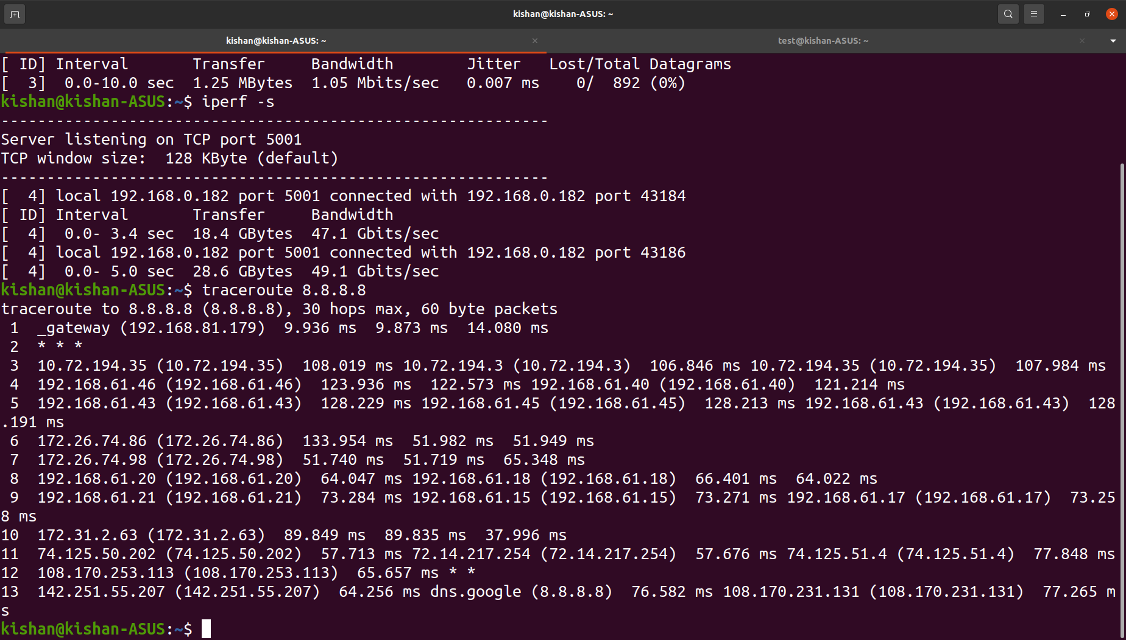
Examples
Traceroute on an IP, shows hops it took to reach destination.
$traceroute [ip_address]
By default max hops on windows is 30.

Slide 25
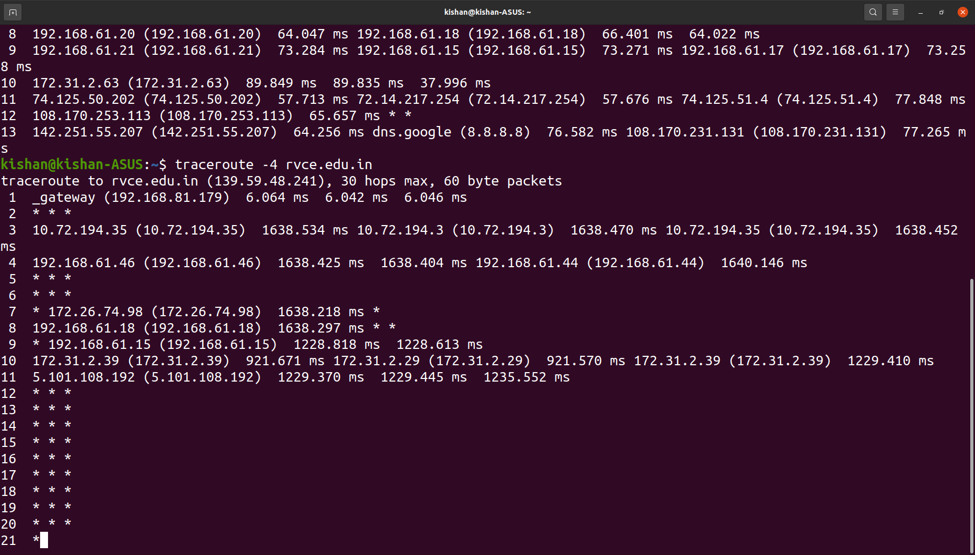
Forcing traceroute to use IPV4 only.
$traceroute -4 [domain/ip_address]

Slide 26
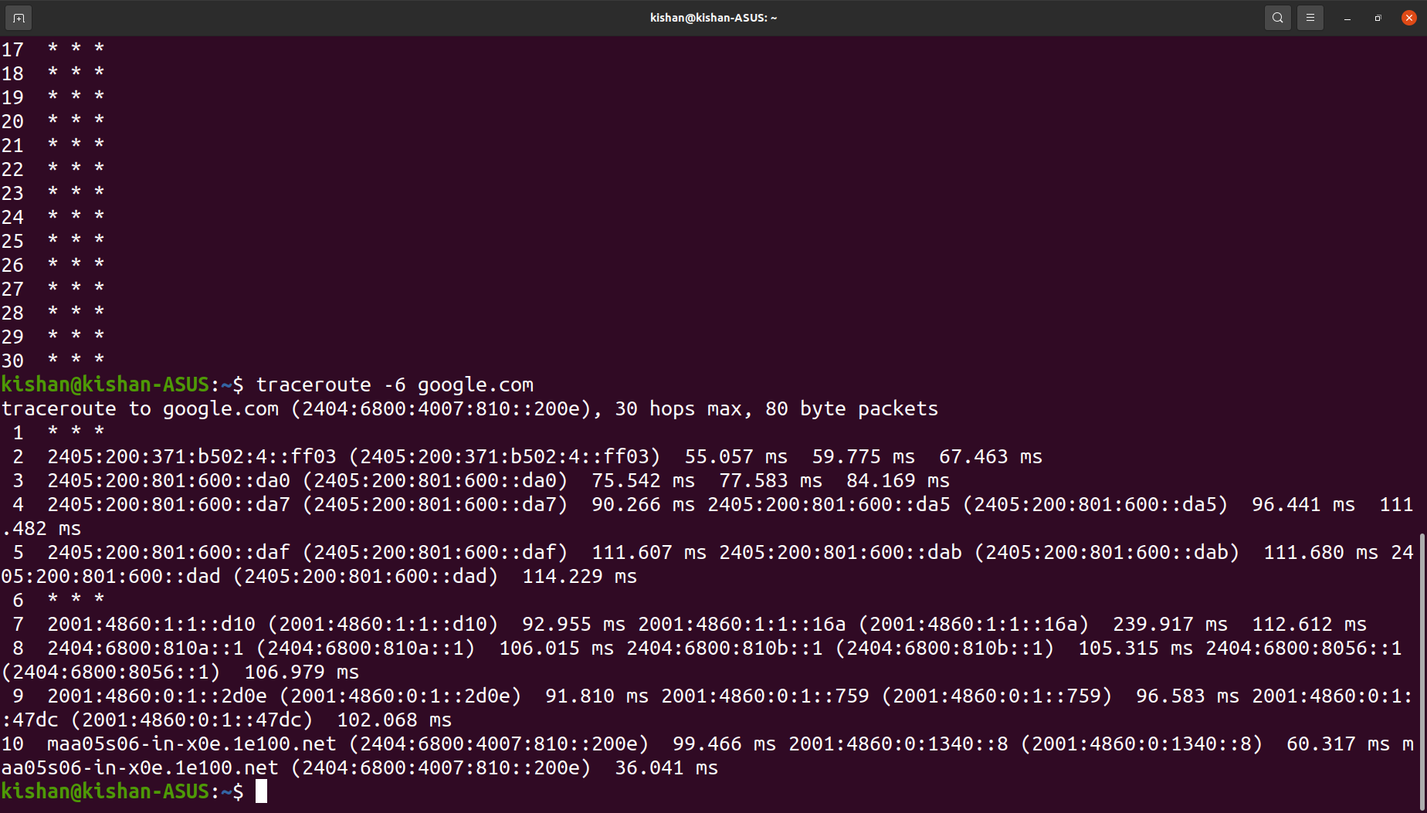
Forcing traceroute to use IPV6 only.
$traceroute -6 [domain/ip_address]
Traceroute is better than ping it not only pings final destination but also routers and measures RTT of datapacket from each router and destination.

Slide 27
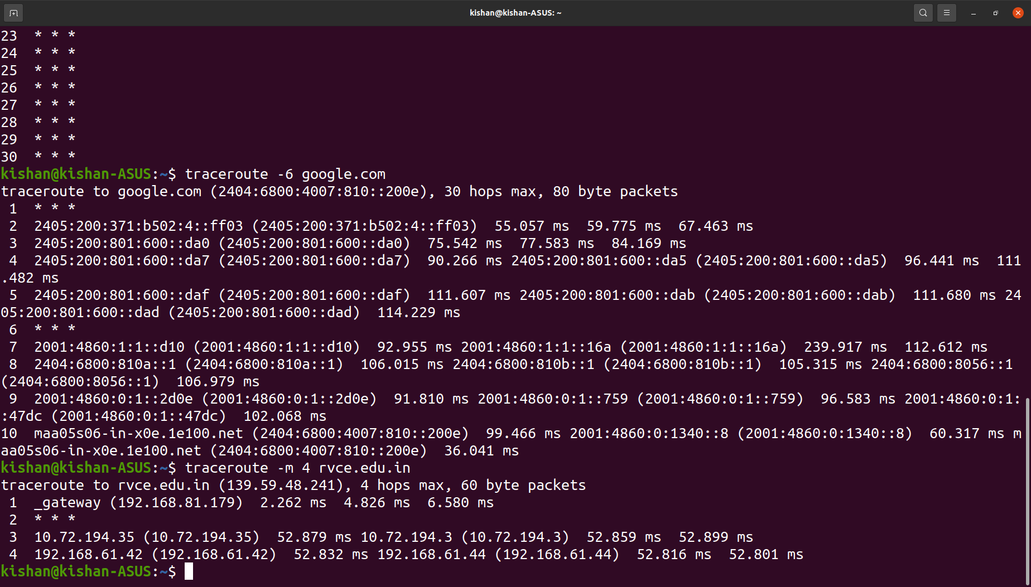
Setting max number of N hops to reach destination(Setting TTL of packet)
$traceroute -m N [domain/ip_address]

Slide 28
$tcpdump command
Purpose
Powerfull & widely used command-line packet sniffer or package analyzer tool.Used to capture or filter TCP/IP packets that are received or transfered over a network on a specific interface.
Can also save captured packets in a file for future analysis in pcap format.
Syntax
$ tcpdump [ -AbdDefhHIJKlLnNOpqStuUvxX# ] [ -B buffer_size ] [ -c count ] [ -C file_size ] [ -G rotate_seconds ] [ -F file ] [ -i interface ] [ -j tstamp_type ] [ -m module ] [ -M secret ] [ --number ] [ -Q in|out|inout ] [ -r file ] [ -V file ] [ -s snaplen ] [ -T type ] [ -w file ] [ -W filecount ] [ -E spi@ipaddr algo:secret,... ] [ -y datalinktype ] [ -z postrotate-command ] [ -Z user ] [ --time-stamp-precision=tstamp_precision ] [ --immediate-mode ] [ --version ] [ expression ]

Slide 29
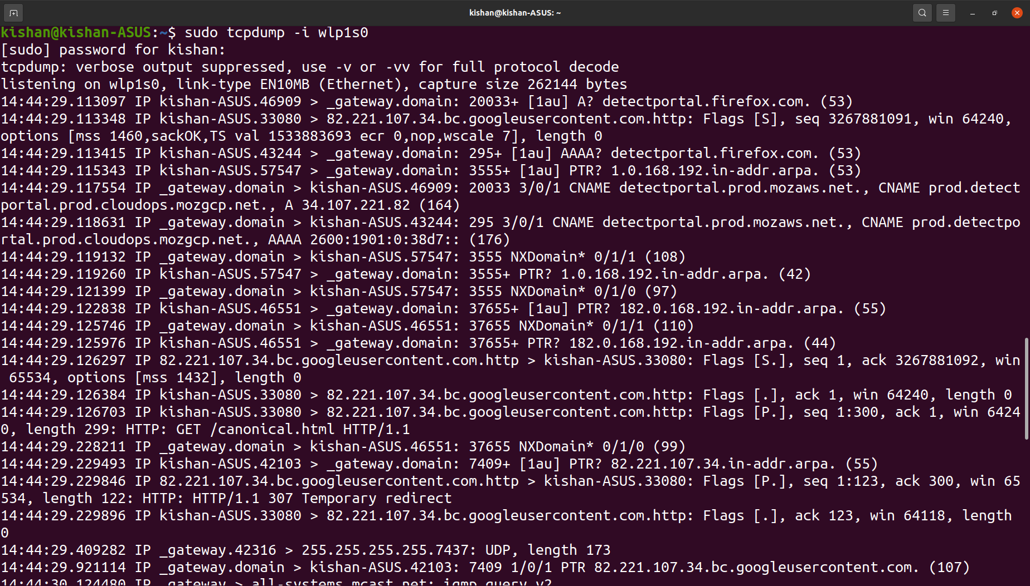
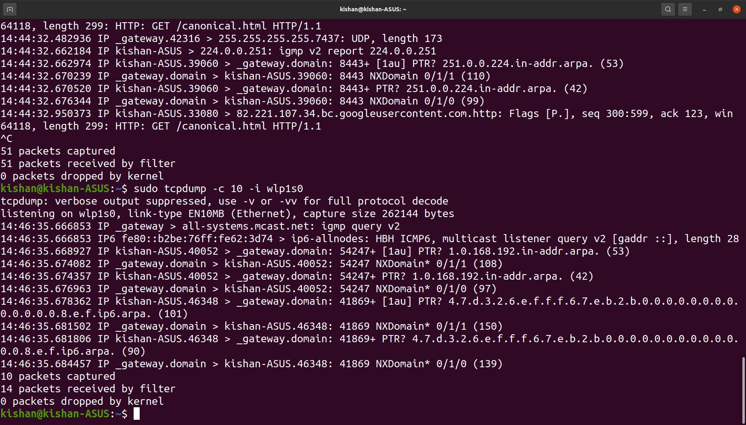
Examples
Capture packets from specific interface.
$sudo tcpdump -i [interface name]
Capture only N number of packets.
$sudo tcpdump -c N -i [interface name]

Slide 30
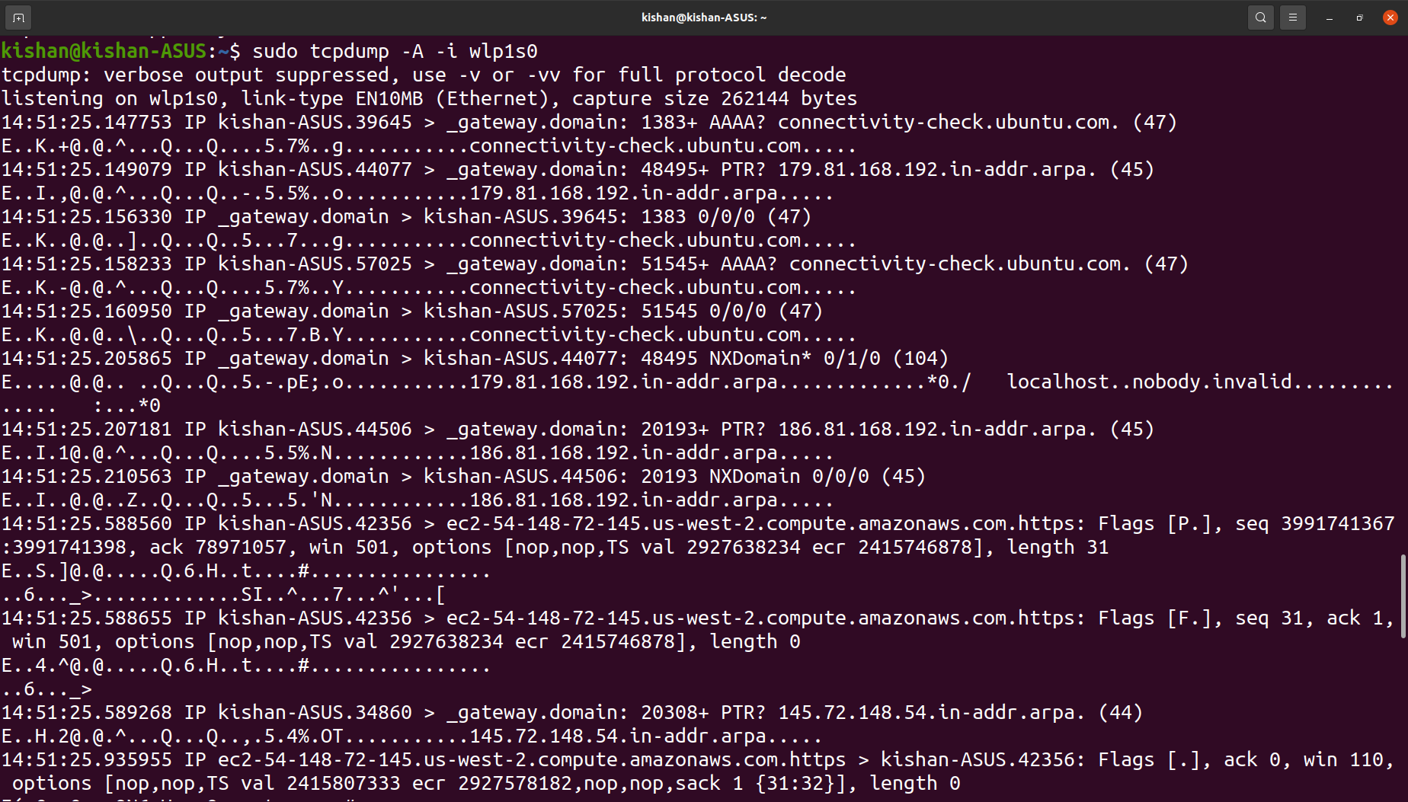
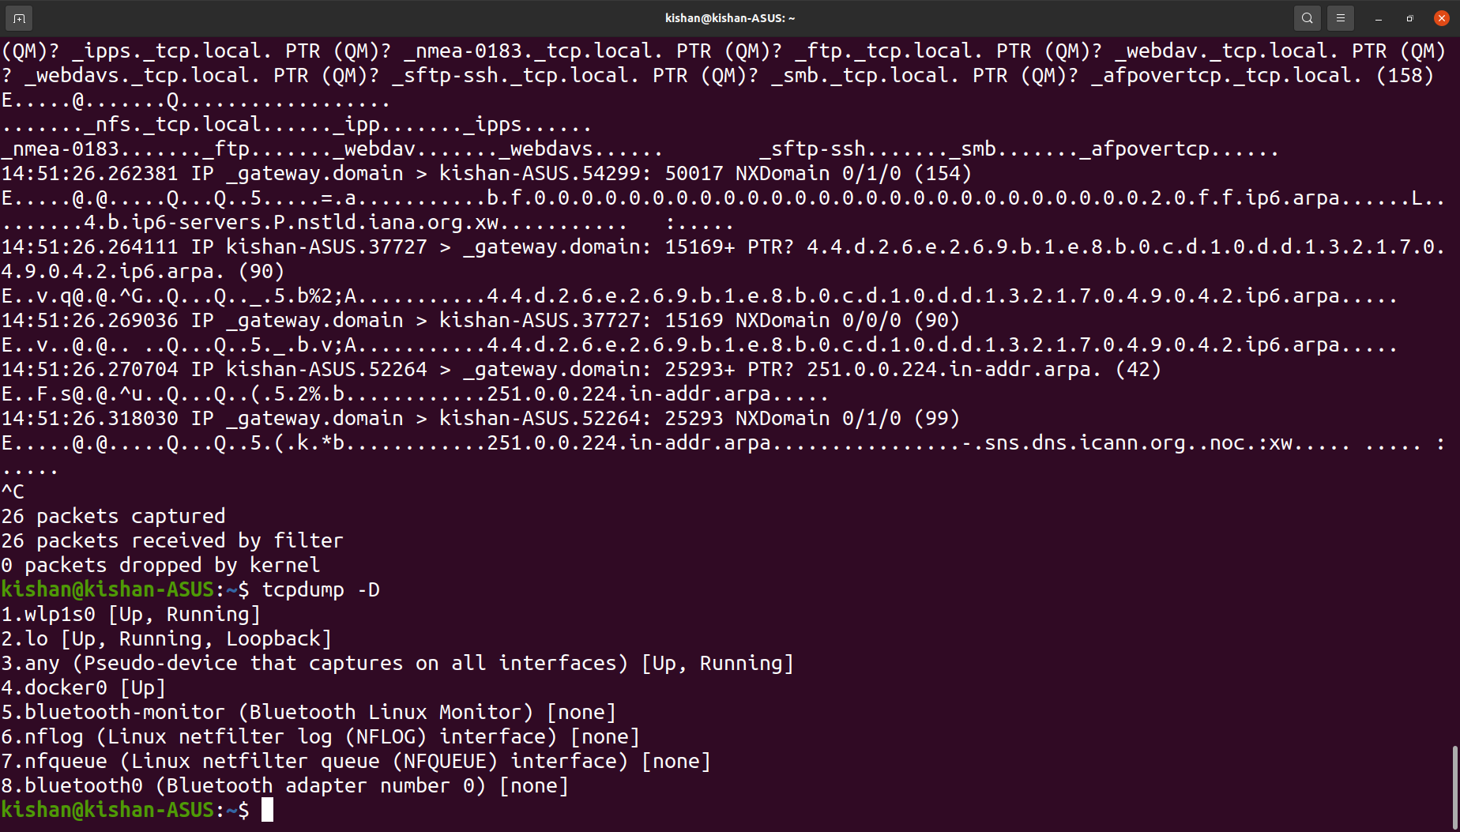
Print captured packets in ASCII.
$tcpdump -A -i [interface name]
Display all available interfaces.

Slide 31
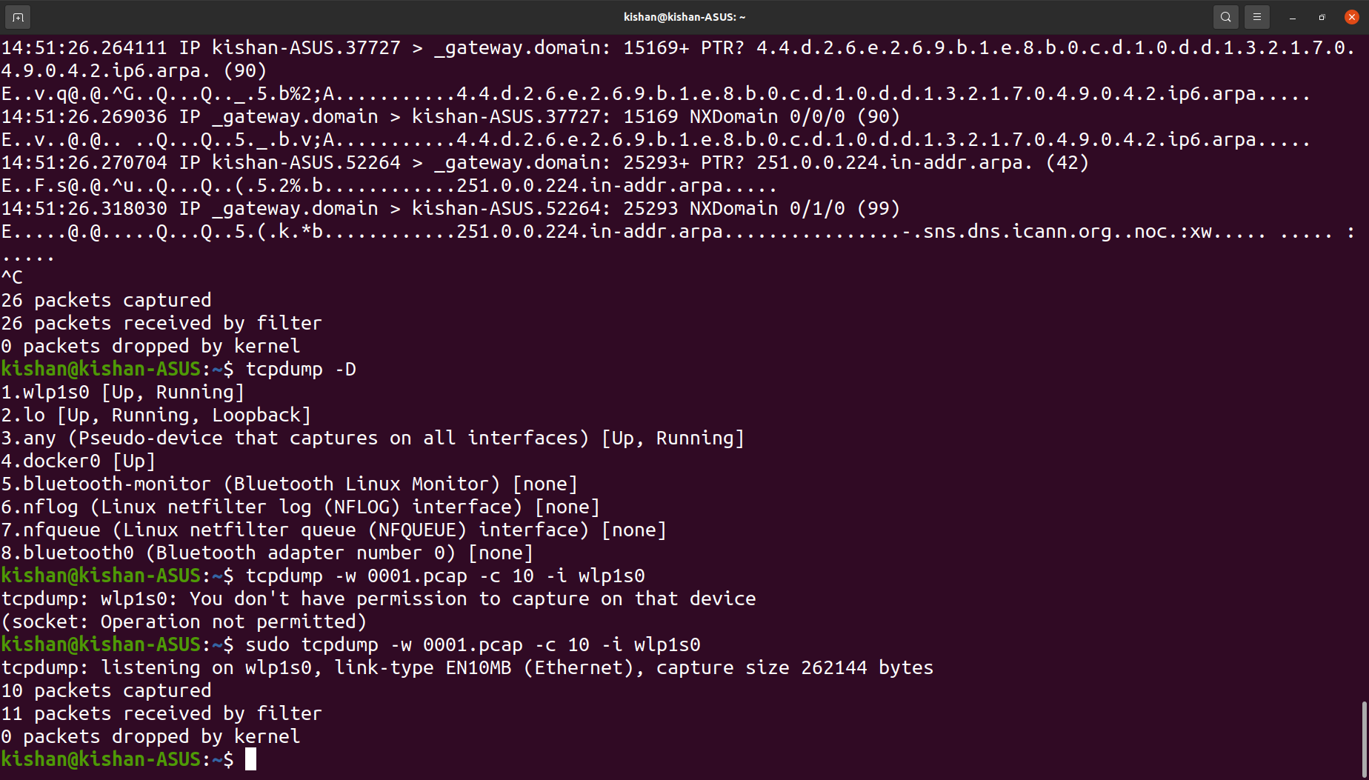
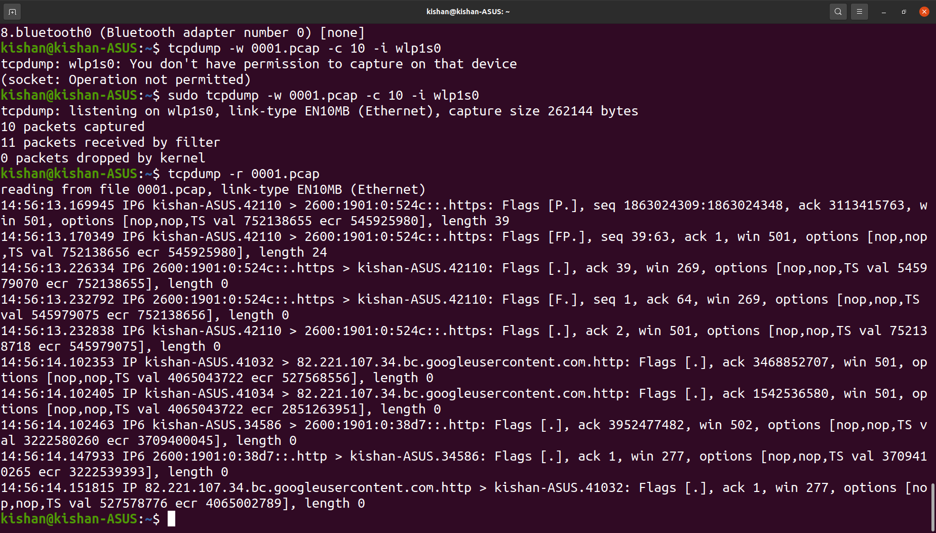
Capture and save packet.
$sudo tcpdump -w file.pcap -i [interface name]
To read captured packet.
$sudo tcpdump -r 0001.pcap

Slide 32
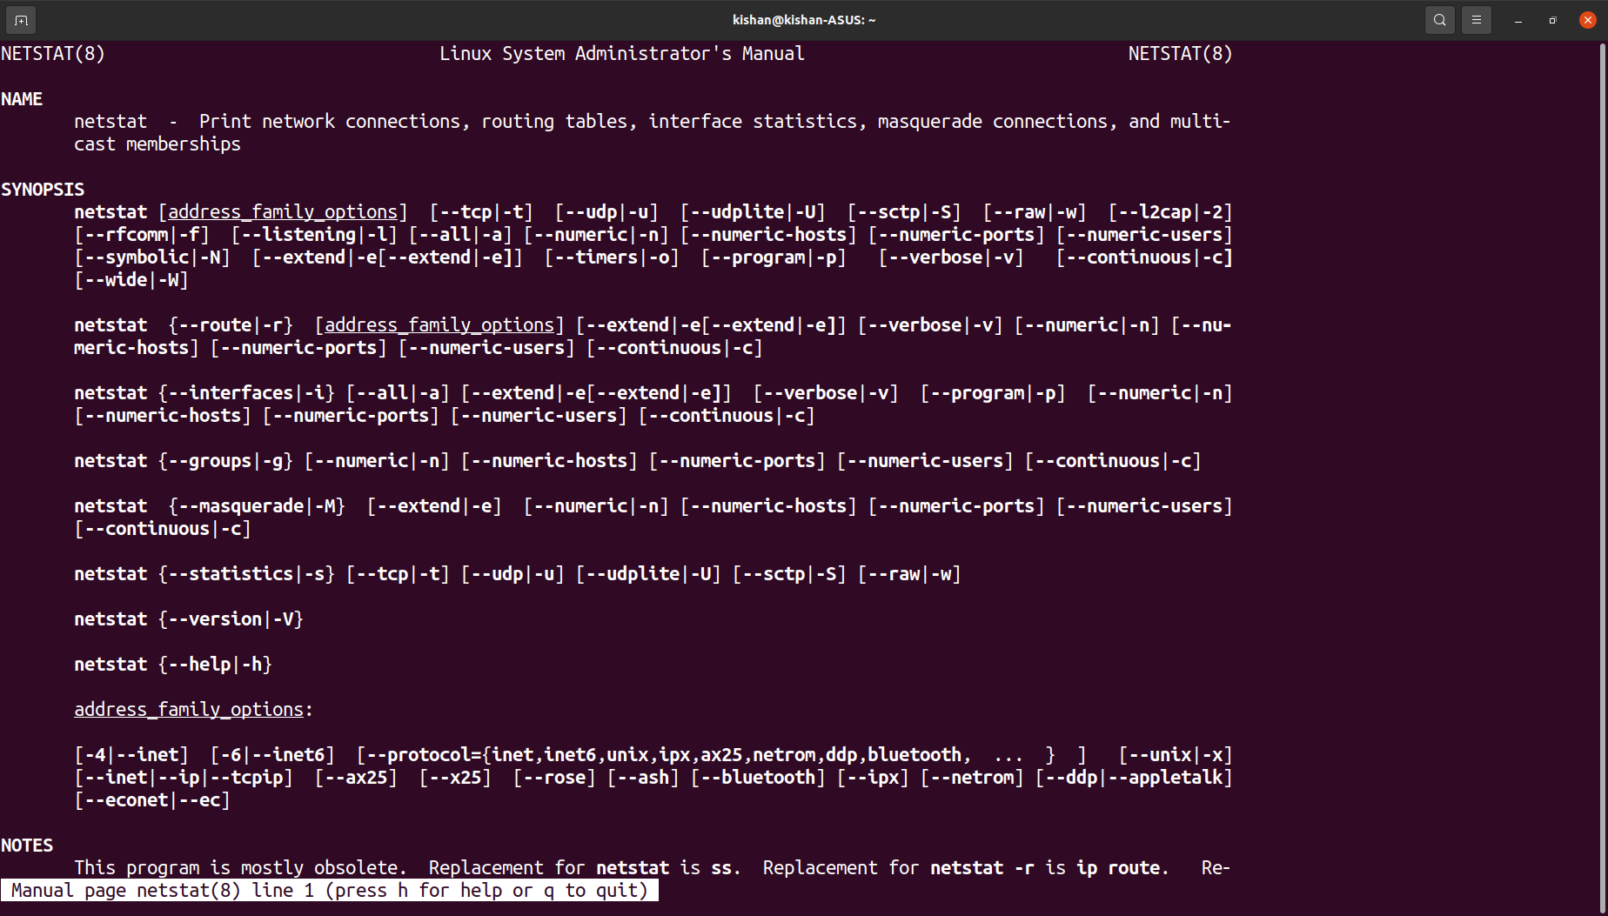
$netstat command
Purpose
Monitoring network connections both incoming and outgoing as well as to view routing tables, interface statistics, etc.
Basic network service debugging tool, tells what port are open & whether any program is listening to that port.
Syntax

Slide 33
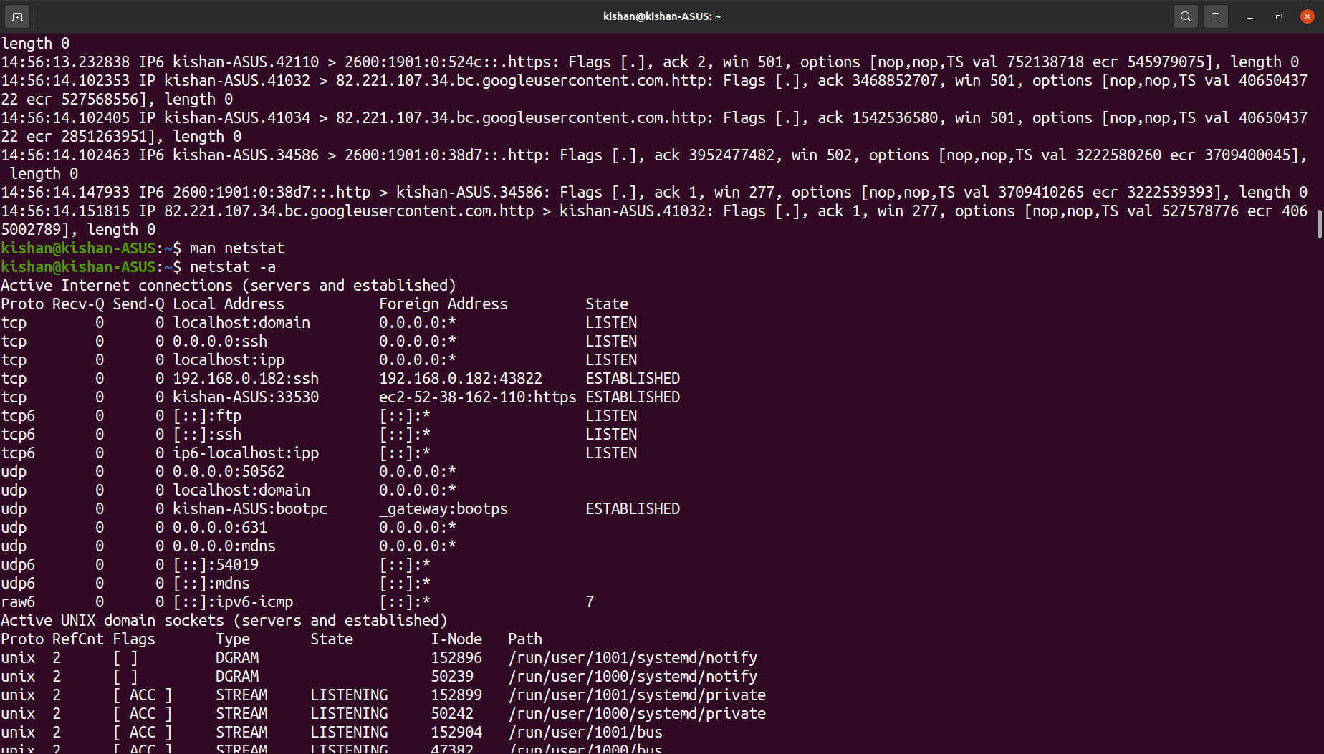
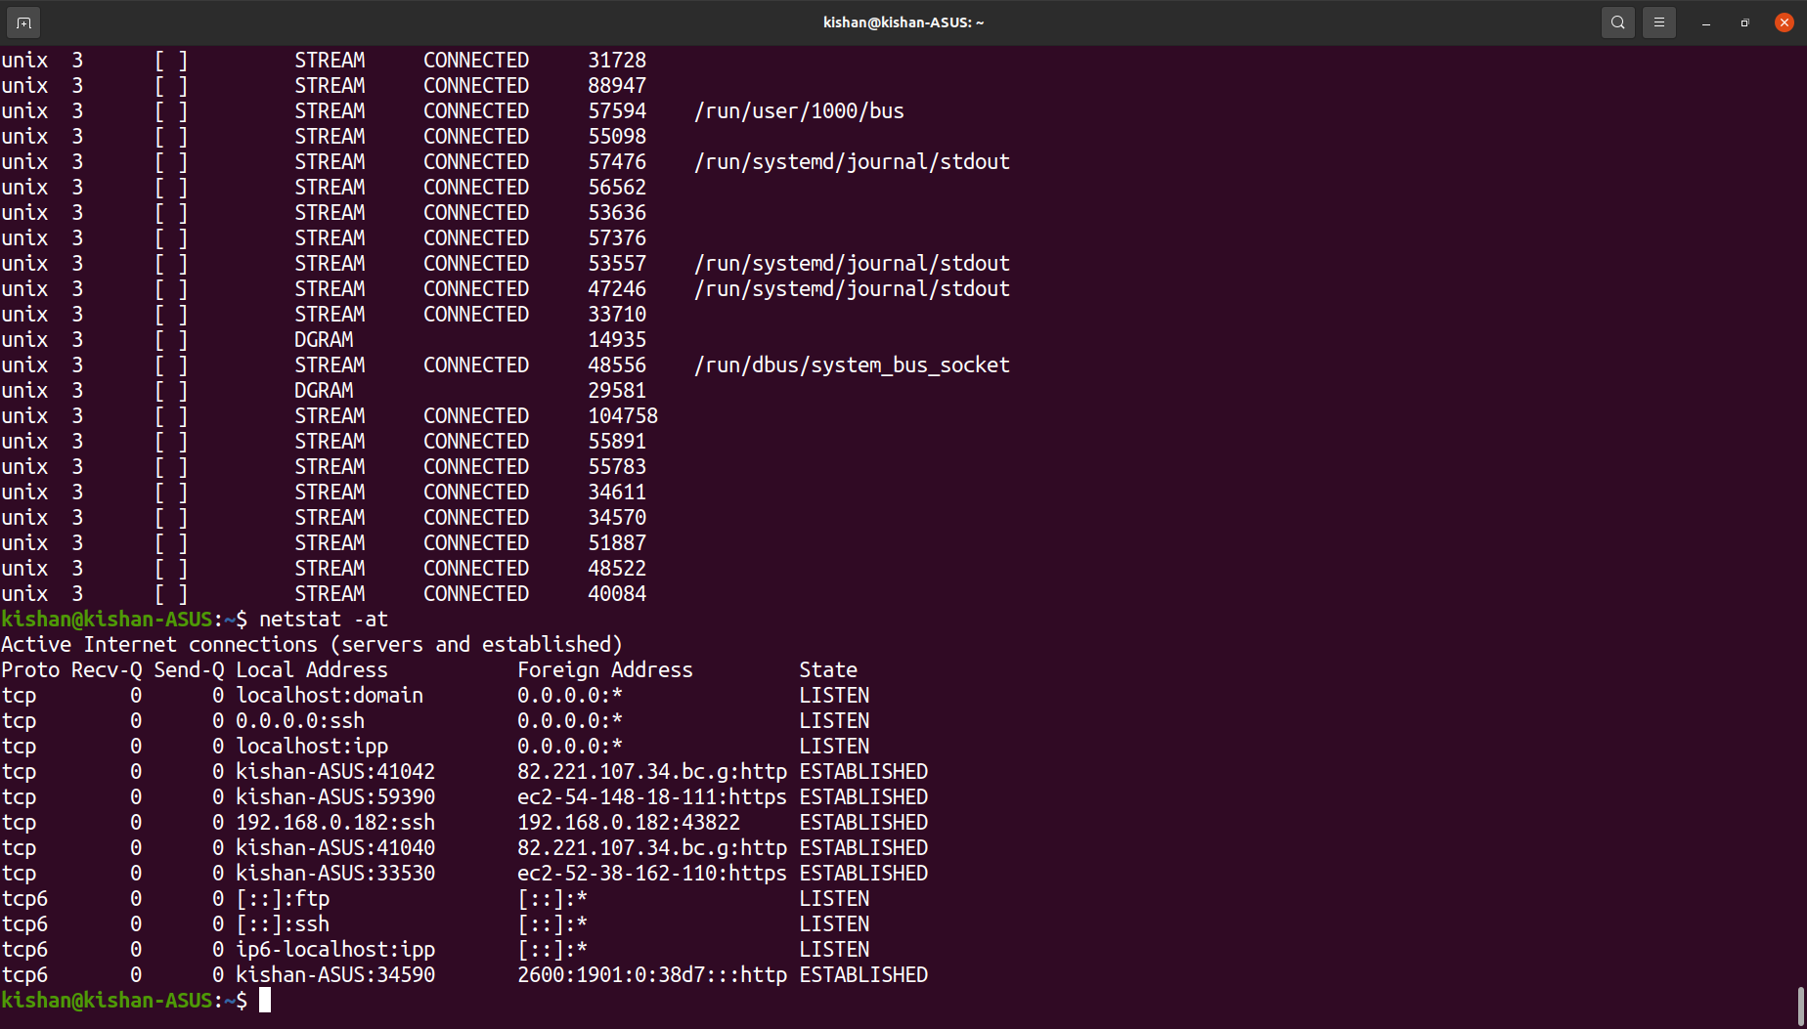
Examples
Listing all listening ports of TCP and UDP.
$netstat -a
Listing TCP port connections.
$netstat -at

Slide 34
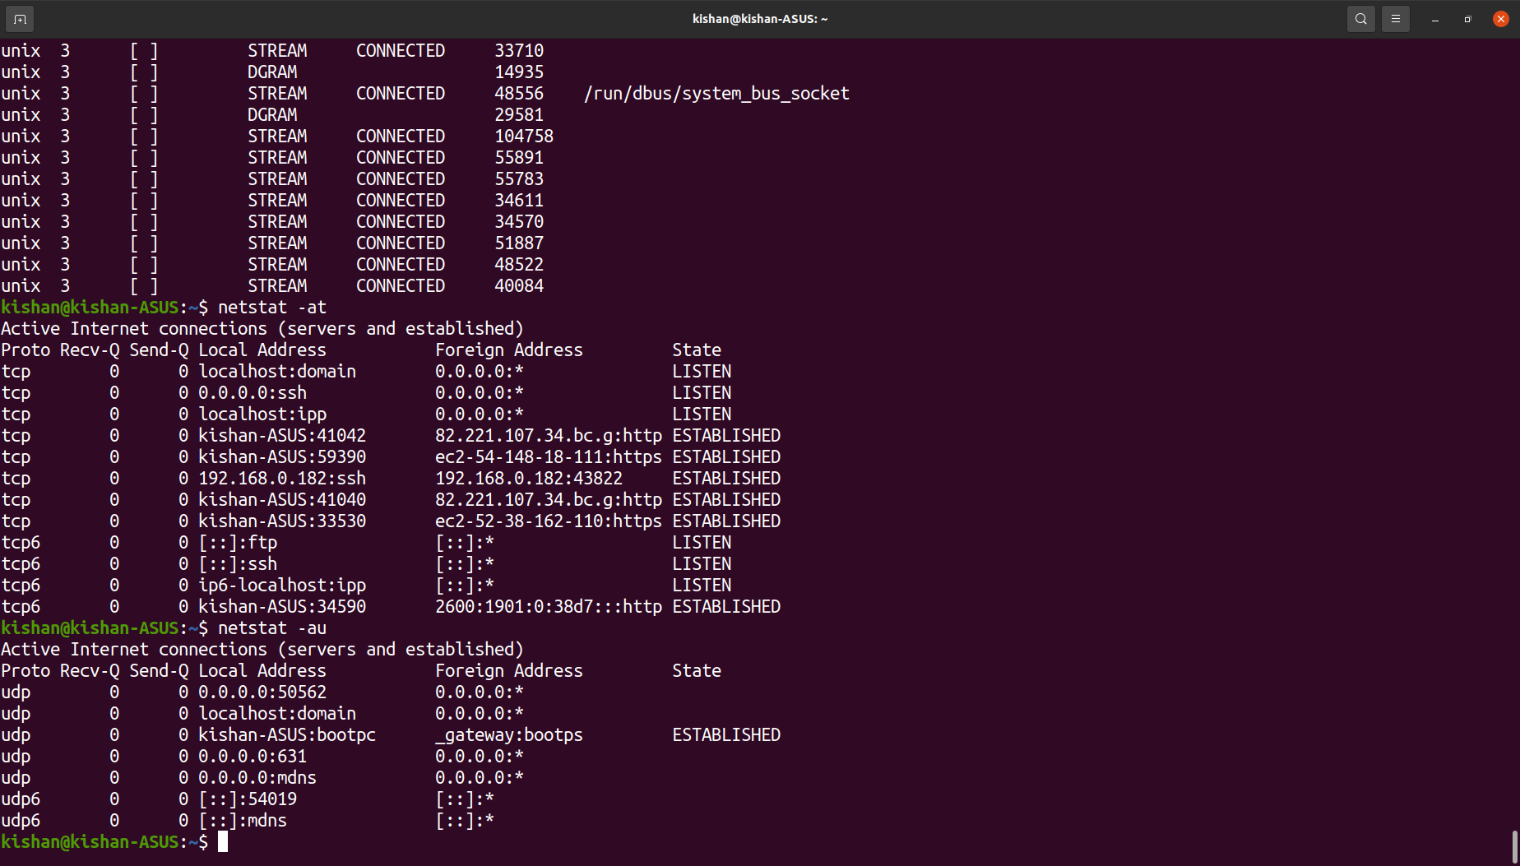
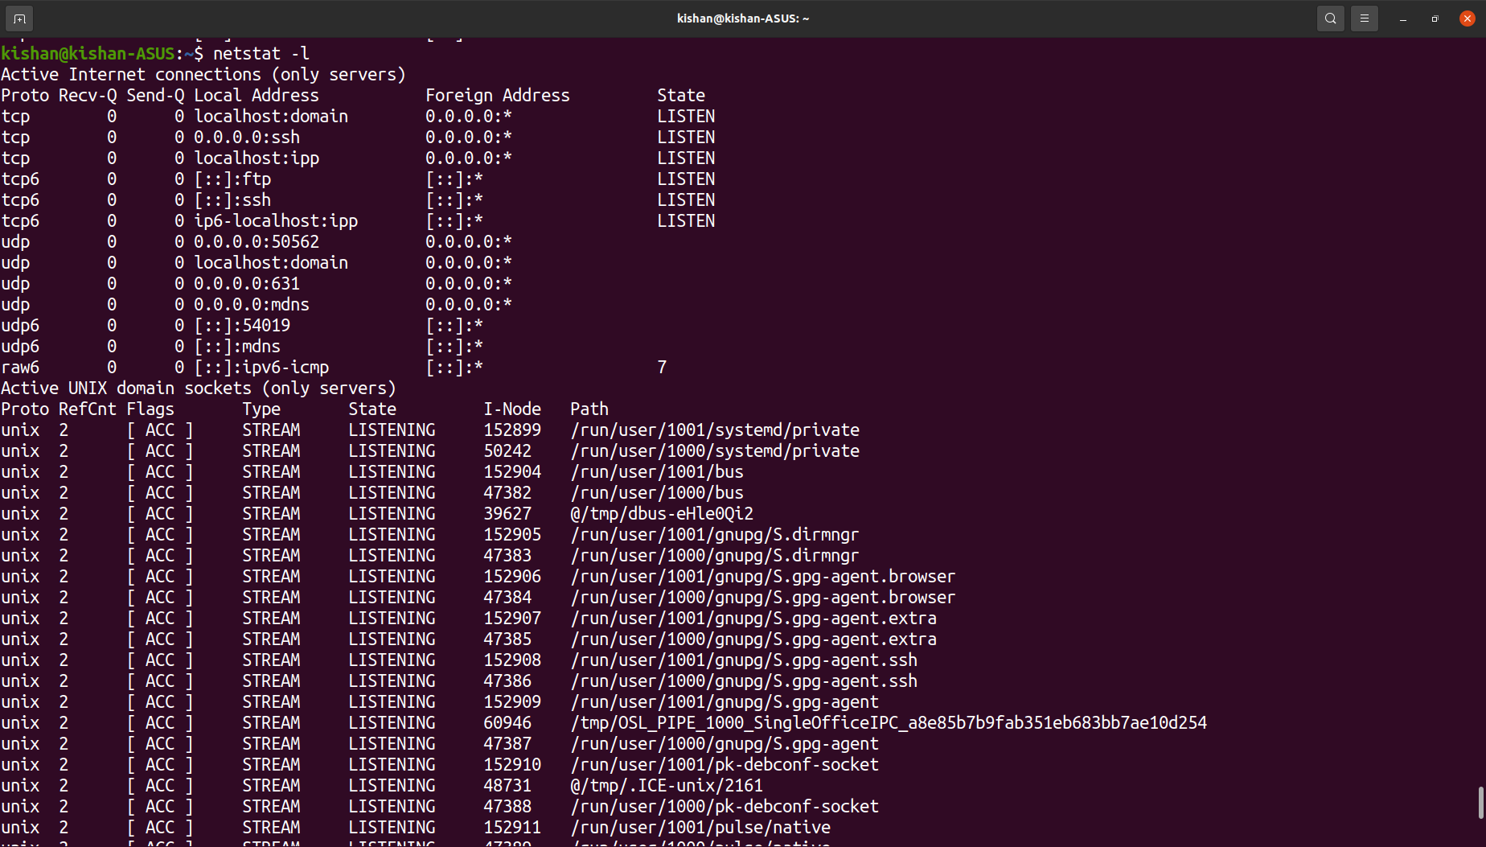
Listing all UDP ports.
$netstat -au
Listing all active ports.
$netstat -l

Slide 35
$ss command
Purpose
Similar to netstat, used to dump socket statistics.
Displays more TCP, UDP, state information, etc.
Utility to investigate sockets.
Syntax
$ss [options] [ FILTER ]

Slide 36
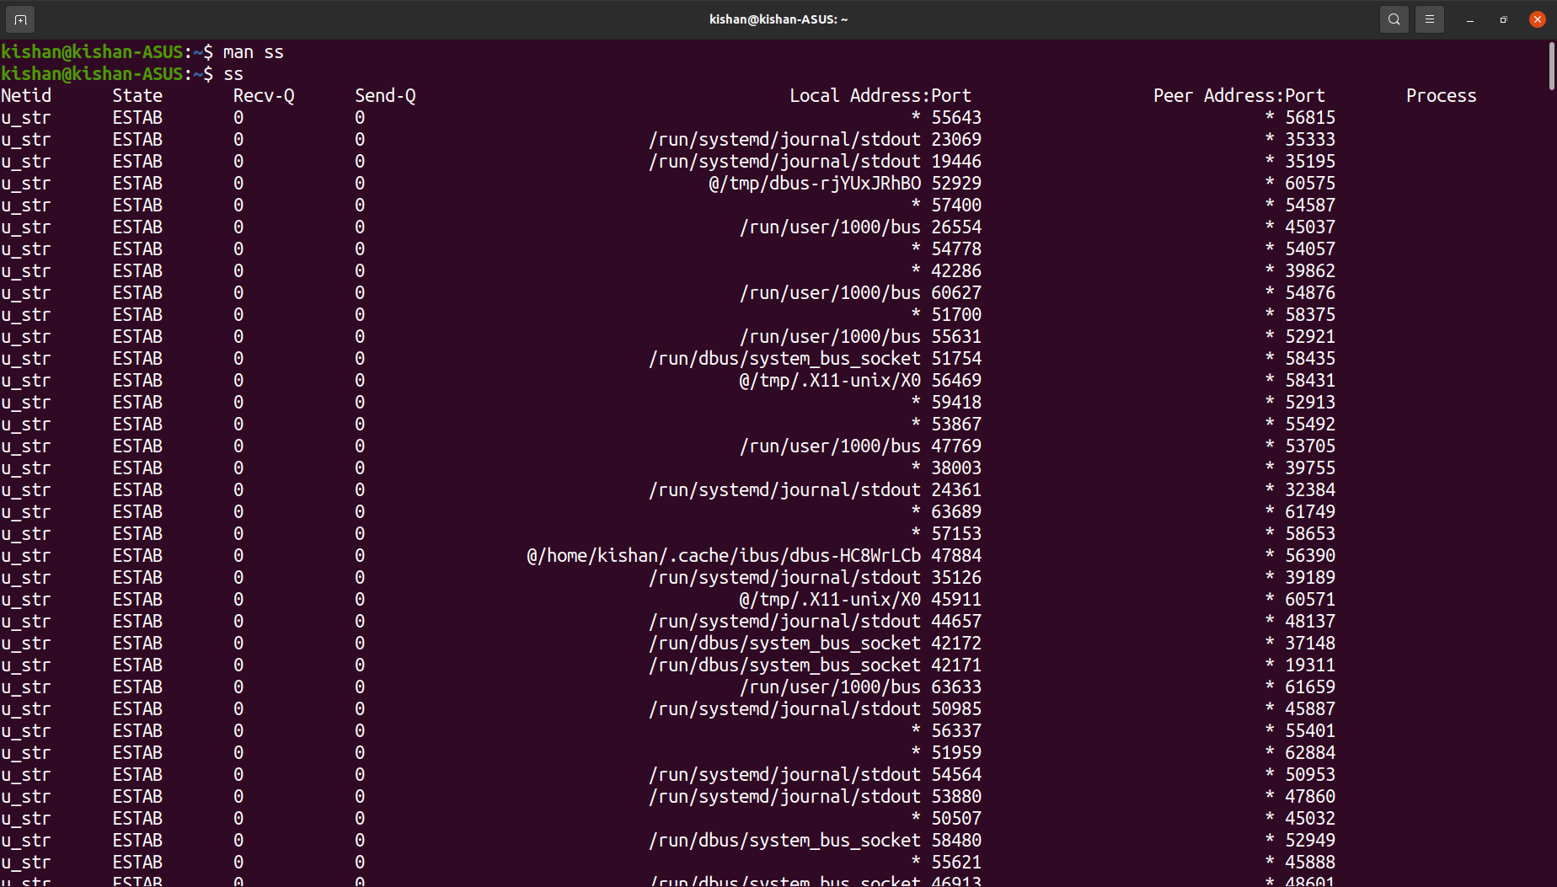
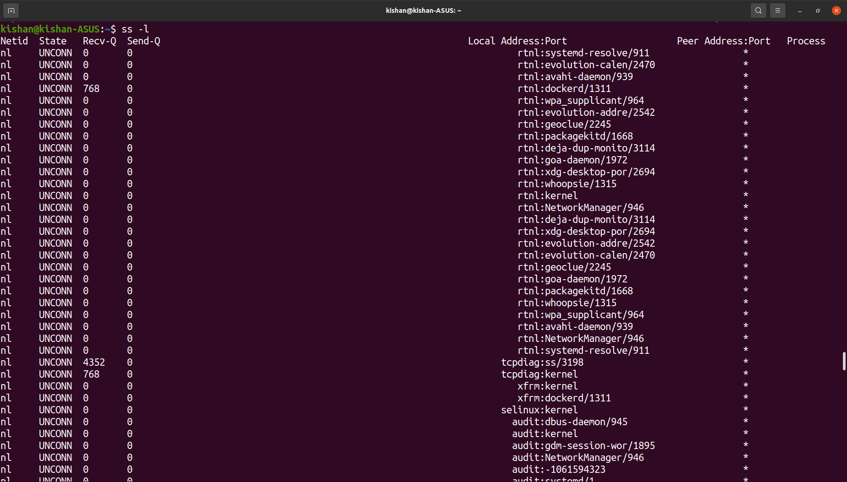
Examples
ss command without any arguments will return a complete list of TCP sockets with established connections.
$ss
Only current listening sockets.
$ss -l

Slide 37
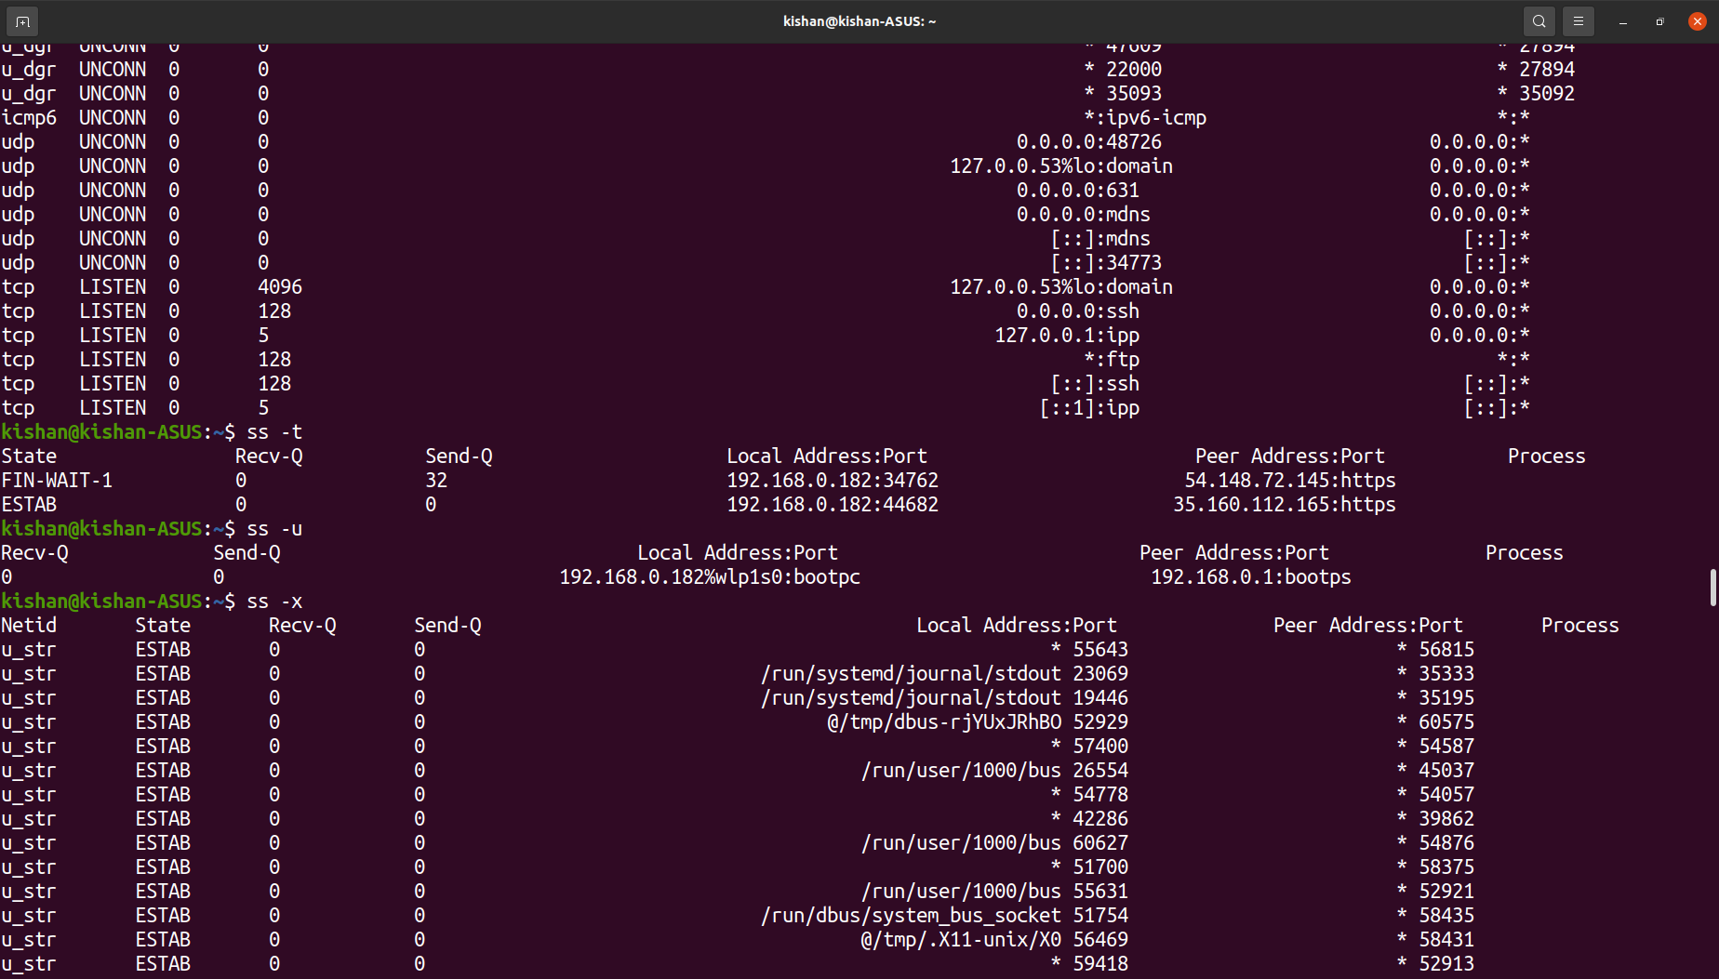
To see only specific connections.
TCP Connections
$ss -t
UDP Connections
$ss -u
UNIX Connections
$ss -x

Slide 38
$ssh command
Purpose
Secure Socket Shell is a network protocol that enablessecure connection between two systems.
System admins use ssh utilities to manage machine, move, copy files between systems.
Syntax
$ssh [-46AaCfGgKkMNnqsTtVvXxYy] [-B bind_interface] [-b bind_address] [-c cipher_spec] [-D [bind_address:]port] [-E log_file] [-e escape_char][-F configfile] [-I pkcs11] [-i-identity_file] [-J destination] [-L address] [-l login_name] [-m mac_spec] [-O ctl_cmd] [-o option] [-p port] [-Q query_option] [-R address] [-S ctl_path] [-W host:port] [-w local_tun[:remote_tun]] destination [command]

Slide 39
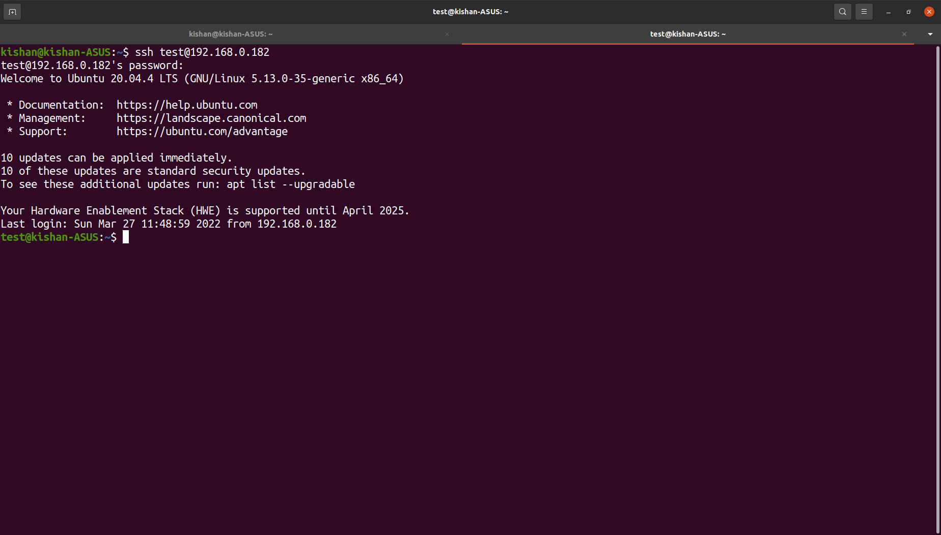
Examples
To connect to remote user/machine you need IP address and name.
$ssh [username@IP_address] / [IP_Address]
Use different port for ssh connection when connection is refused.
$ssh [username@IP_Address] -p [port_Number]
Ex : ssh test.server.com -p 3322

Slide 40
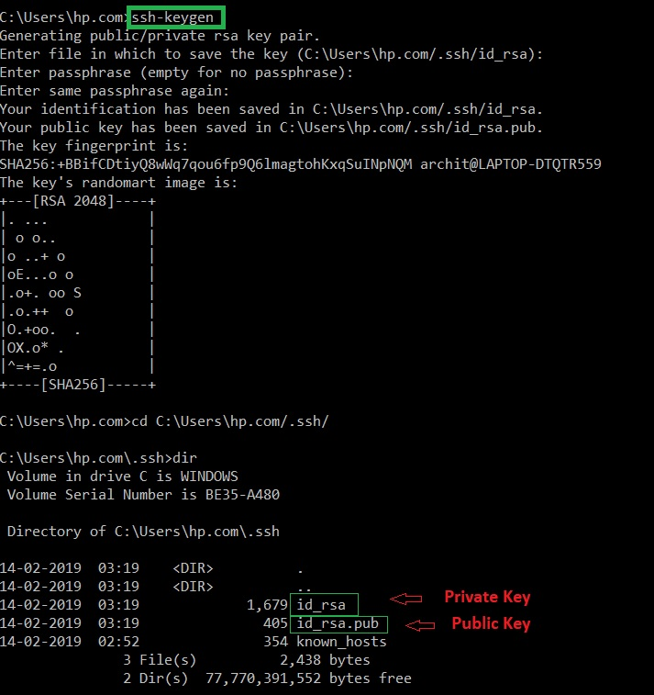
Generate ssh key using ssh-keygen.
$ssh-keygen -t rsa

Slide 41
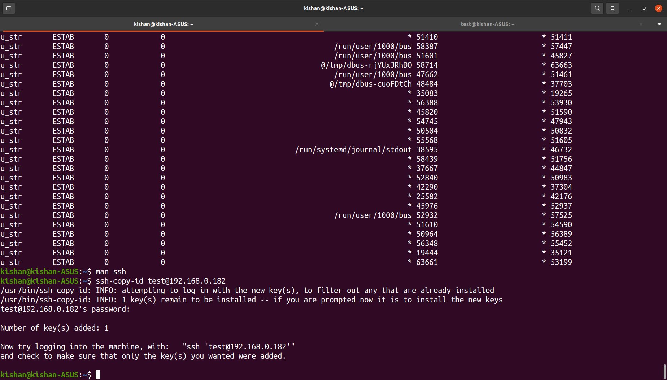
Copy public ssh key.
$ssh-copy-id [ip_address] //Different machine
$ssh-copy-id [username@IP_Address] //Different user

Slide 42
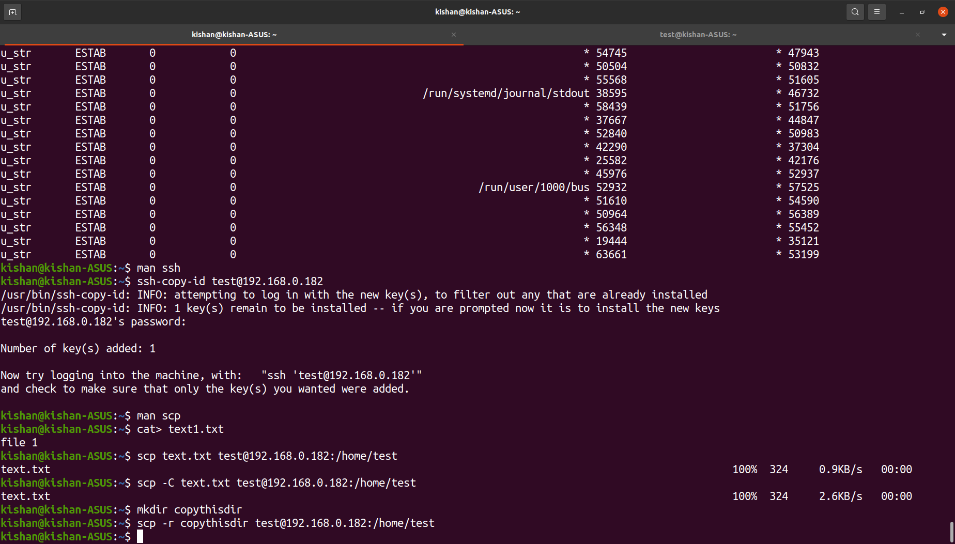
$scp command
Purpose
Securely copy file between hosts on a network.
Uses secure shell protocol.
Syntax
$scp [-346BCpqrTv] [-c cipher] [-F ssh_config] [-i identity_file] [-J destination] [-l limit] [-o ssh_option] [-P port] [-S program] source ... target
Examples
Copy a directory.
$scp -r [directory] username@IP_Address:/destination/path

Slide 43
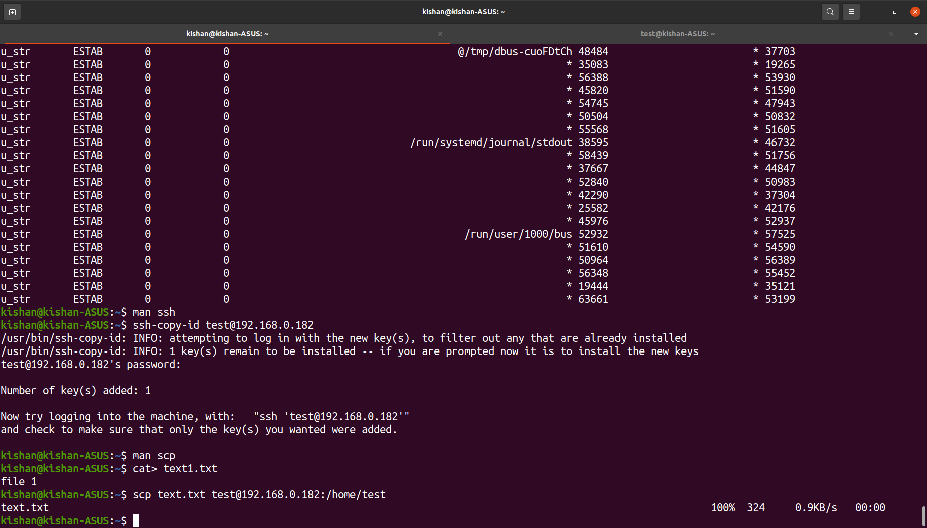
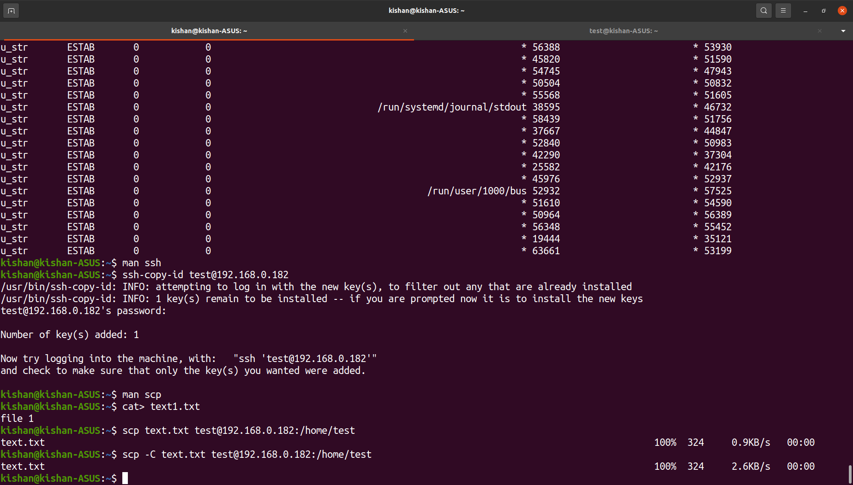
Copy a file using scp.
$scp [filename/directory] username@IP_Address : /destination/path
Copy Through specific port if original port is busy.
$scp -P <PortNumber> <filename> username@IP_Address : /destination/path
Compress and copy files for faster transfer.
$scp -C filename username@IP_Address : /destination/path

Slide 44
$sftp command
Purpose
Runs over secure shell protocol on port 22 by default to establish a secure connection.
Allows to transfer file between 2 machines securely.
Syntax
$sftp [-46aCfpqrv] [-B buffer_size] [-b batchfile] [-c cipher] [-D sftp_server_path] [-F ssh_config] [-i identity_file] [-J destination] [-l limit] [-o ssh_option] [-P port] [-R num_requests] [-S program] [-s subsystem | sftp_server] destination

Slide 45
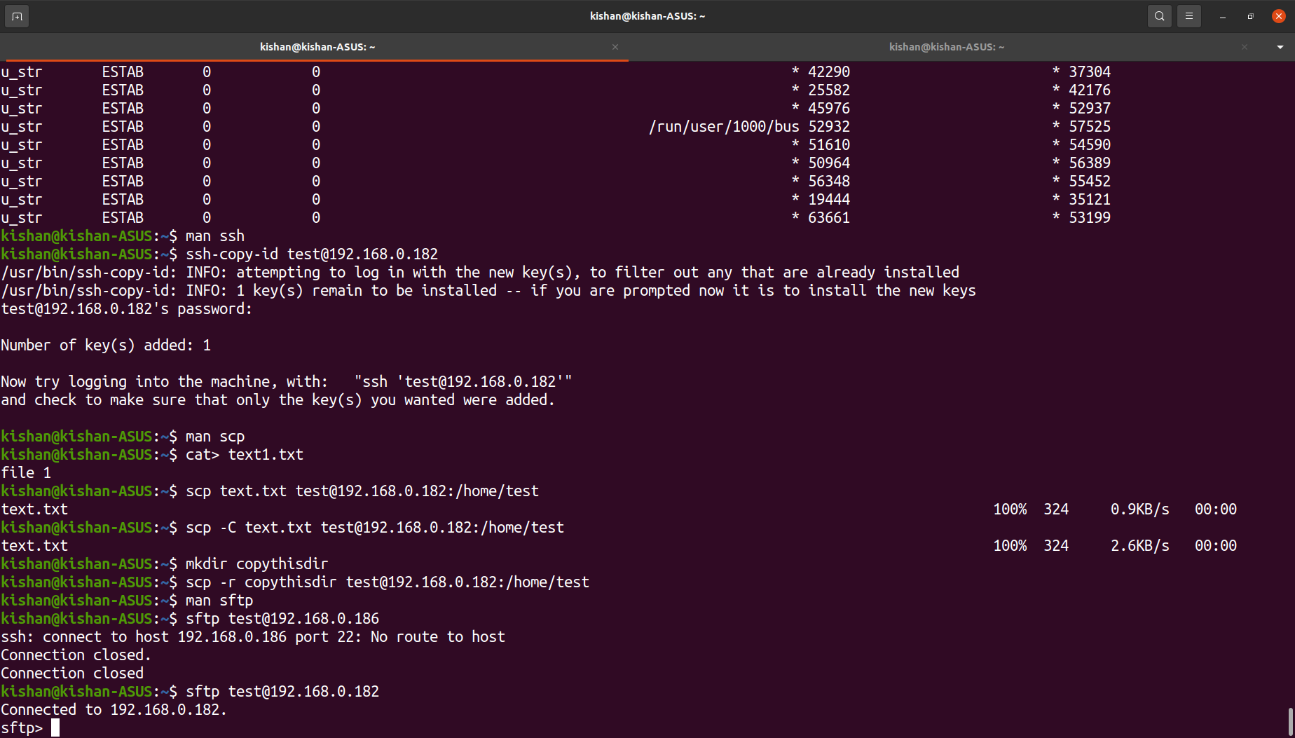
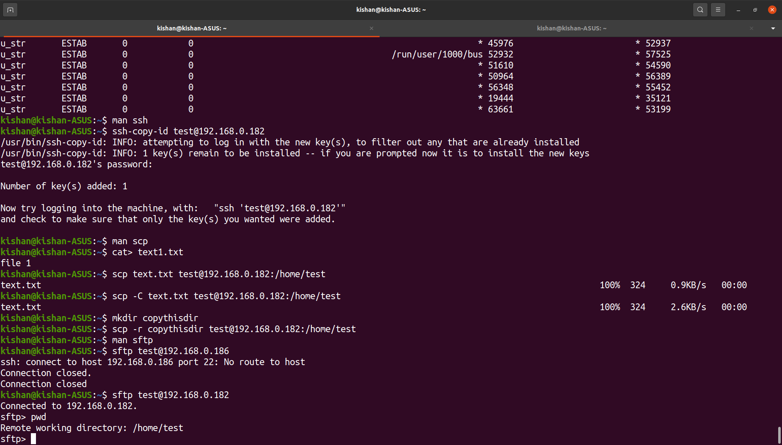
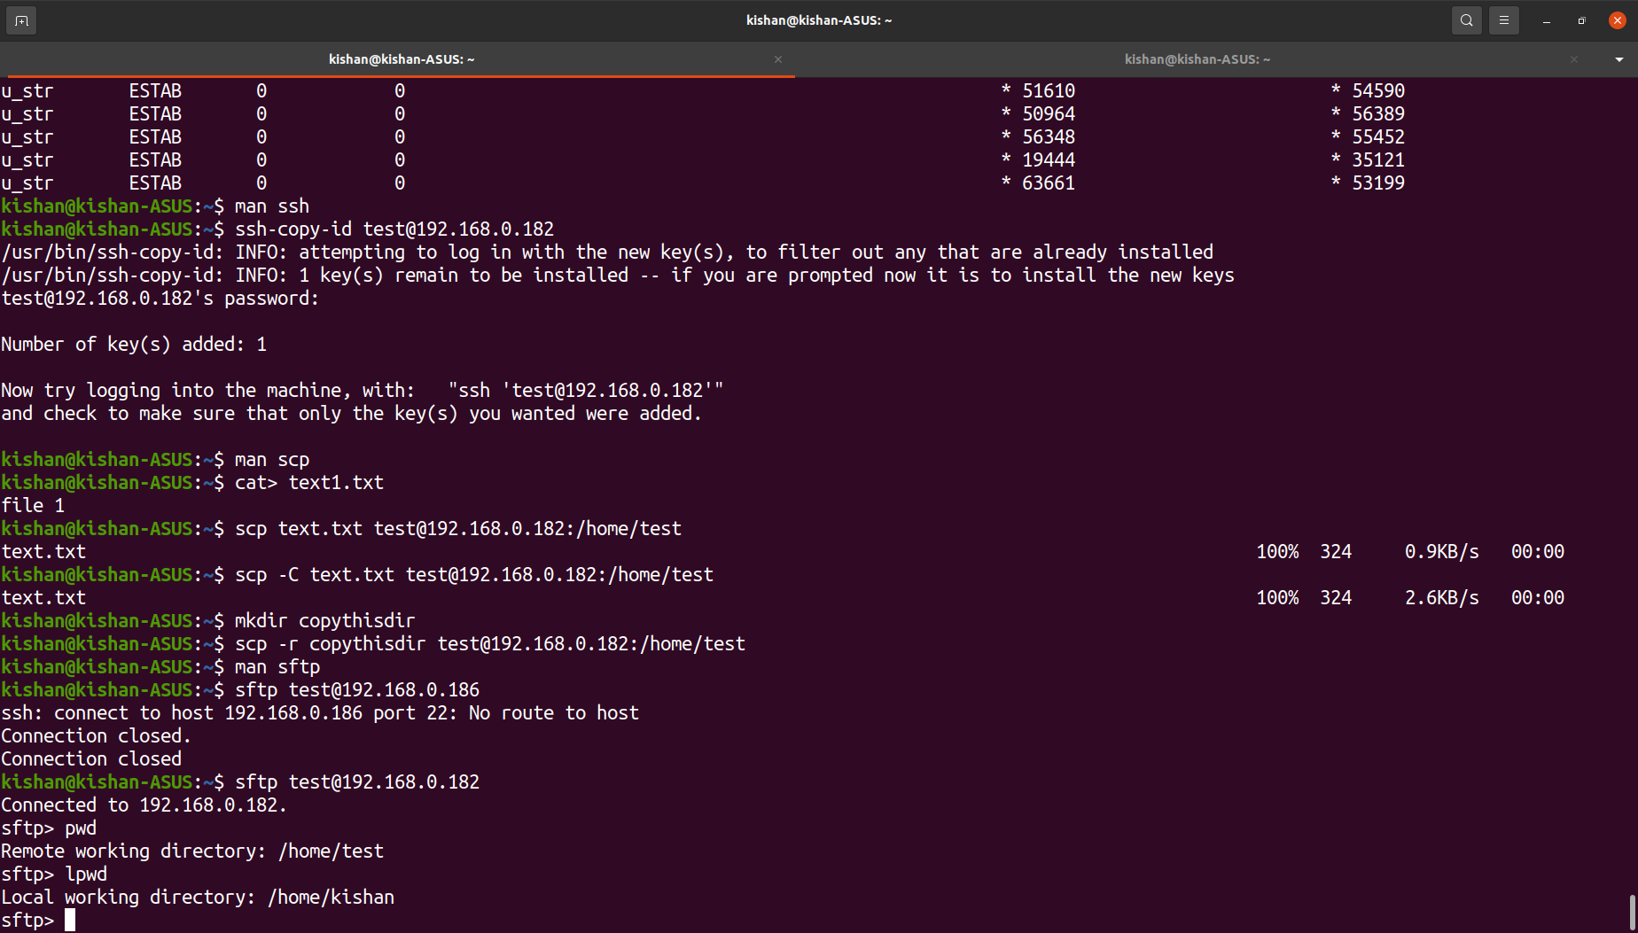
Examples
First use below command to enter sftp prompt.
$sftp username@IP_Address
Password for user : ****
sftp>
To see remote working directory(connected machine)
sftp>pwd
To see local working directory(local machine)
sftp>lpwd

Slide 46


Put single file / multiple files into remote machine.
sftp>put text1.txt //Single File uploaded
sftp>mput *.FileExtension //Mutiple files uploaded
Download single file / mutiple files into local machine.
sftp>get text1.txt //Single File downloaded
sftp>mget *.FileExtension //Multiple Files downloaded

Slide 47
$ifconfig command
Purpose
Used to configure the kernel-resident network interfaces.
It is used at boot time to setup interfaces as necessary.
After that, it is usually only needed when debugging or when system tuning is needed.
Syntax
$ifconfig [-v] [-a] [-s] [interface]
$ifconfig [-v] interface [aftype] options | address ...

Slide 48


Examples
Display shorthand information of network interface.
$ifconfig -s [interface_name]
$ifconfig -s
Setting a classfull IP Address from CLI.
$sudo ifconfig [interface] [New IP Add] netmask [subnet mask]

Slide 49


Display all available network interfaces on system.
$ifconfig -a
Activate / deactivate an interface.
$sudo ifconfig docker0 down/up

Slide 50
$telnet command
Purpose
To create remote connection with system over TCP/IP network.
Interactive communication with another host using the TELNET protocol.
Allows us to administrate other systems by the terminal
Syntax
$telnet [-468ELadr] [-S tos] [-b address] [-e escapechar] [-l user] [-n tracefile] [host [port]]

Slide 51

Examples
The interactive shell can be started by executing the telnet command
$telnet
telnet>
execute the help command by typing h.
telnet>h

Slide 52

To create a connection between two systems by telnet command is a simple process, execute the telnet command followed by the hostname.
$telnet IP_Address

Slide 53

Once it is successfully log in, we are operating the other machine remotely
Now, we are logged in, let’s create the text file in that machine.

Slide 54
$dig command
Purpose
The dig command is used to gather DNS information (query DNS server).
Find DNS server lookups, host address, IP Address, mail exchanges, etc.
Verify spam, blacklisting records, ISP DNS server & internet connectivity, etc.
Syntax
$dig [@server] [-b address] [-c class] [-f filename] [-k filename] [-m] [-p port#] [-q name] [-t type] [-v] [-x addr] [-y [hmac:]name:key] [[-4] | [-6]] [name] [type] [class] [queryopt...]
$dig [-h]
$dig [global-queryopt...] [query...]

Slide 55

Examples
Normal Dig command. Answer Section is very important.
$dig

Slide 56


Find IP Address of host.
$dig domain
Get just answer in the output.
$dig +short domain

Slide 57

Get text(TXT) annotations of a domain name.
$dig domain TXT

Slide 58


ANY option gets as much as information as possible.
$dig domain ANY
Trace option lists eacg different server the query goes through to find its final destination.
$dig domain +trace

Slide 59
$nslookup command
Purpose
Popular command to obtain server records, obtain information from DNS server.
Also used to troubleshoot DNS-related problems, query DNS to obtain Domain name or IP Address mapping, etc.
Syntax
$nslookup [-option] [name | -] [server]

Slide 60


Obtain the address record for a domain. It queries to domain name servers and gets the details.
$nslookup domain
Reverse DNS lookup.
$nslookup IP Address

Slide 61

Lookup for any record, view all the available DNS records using ‘-type=any’ option.
$nslookup -type=any domain

Slide 62


Look for ns(name server) record maps (associated) of a domain.
$nslookup -type=ns domain
Lookup for an mx record.
$nslookup -type=mx domain
Similarly look for a record (-type=a), txt record (-type=txt), etc.

Slide 63
Thank You

